Slide 1
Vocab Week 1
A-C

Slide 2
Act
the division in the performance of the play. Each act has several scenes. Intermission usually happens between acts.

Slide 3
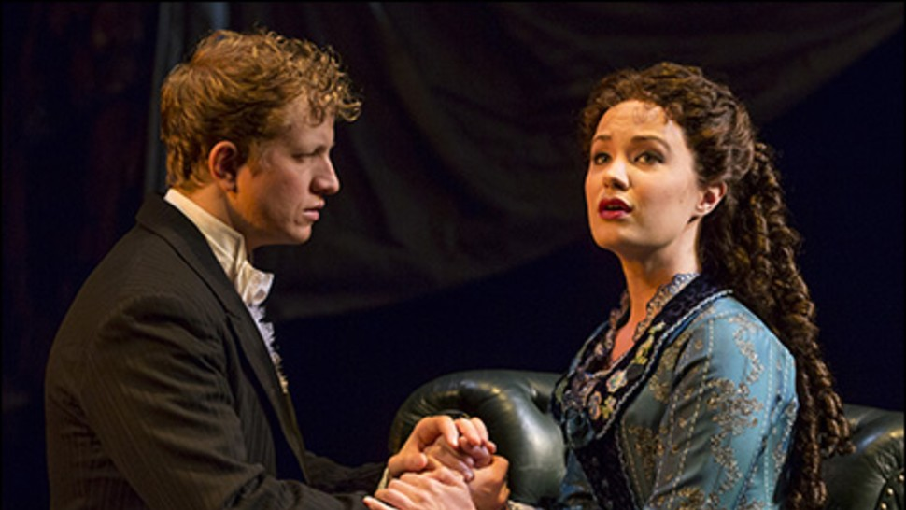
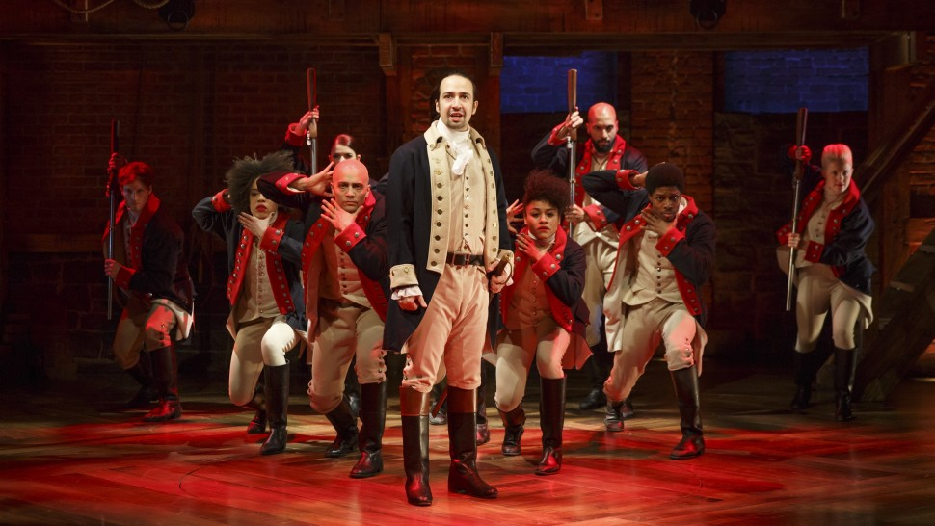
Actor/Actress
a performer in a play.

Slide 4
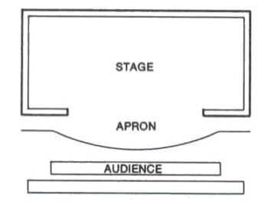
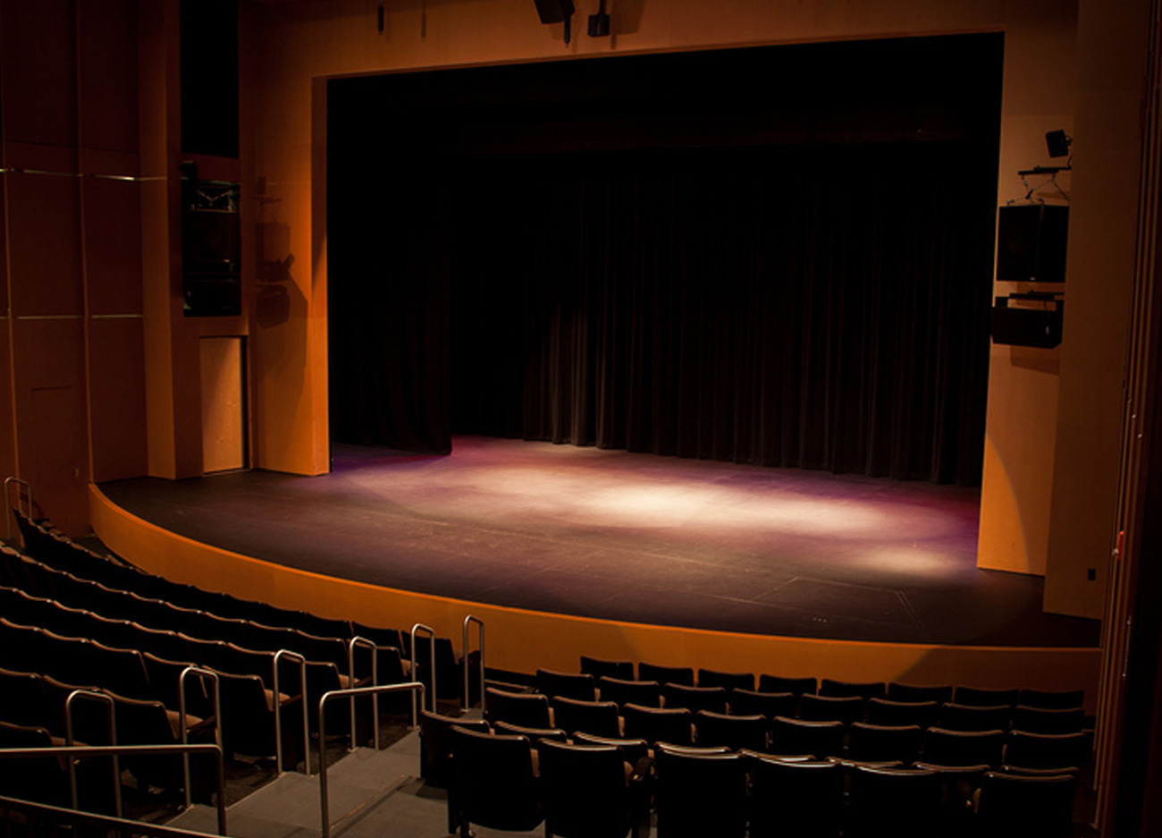
Apron
any part of the stage that extends past the proscenium arch and into the audience or seating area.

Slide 5
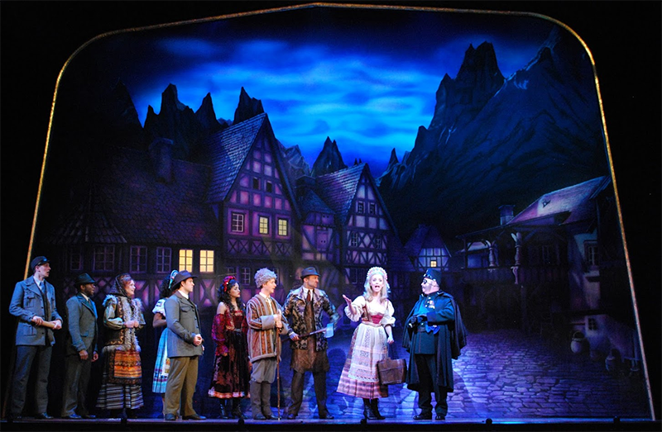
Backdrop
a large drapery of painted canvas that provides cover for upstage.

Slide 6
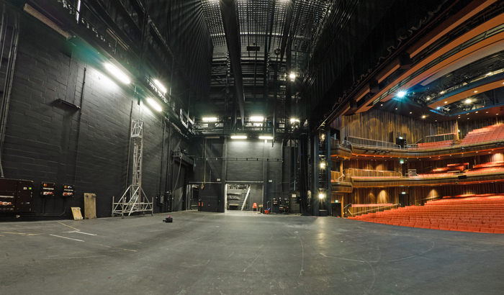
Backstage
the area behind and around the stage that is unseen by the audience. Also known as Wings or Offstage

Slide 7
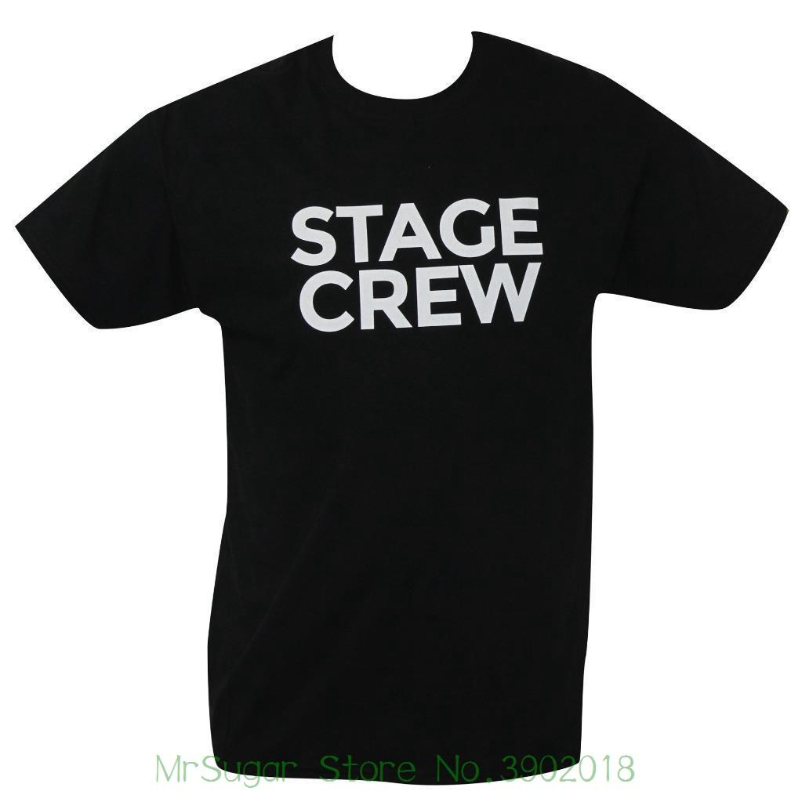
Blacks
the clothing any backstage crew wears during show consisting of black from head to toe. Worn to make crew “invisible”. There are two types: Audition Blacks and Crew Blacks.

Slide 8
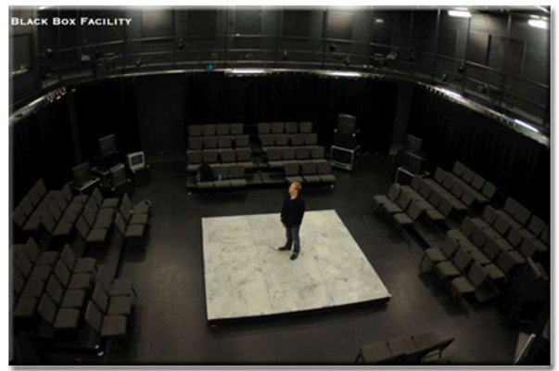
Black Box
a simple indoor performance space with plain black walls and a level floor, typically designed to provide flexibility in the configuration of the stage and the audience seating.

Slide 9
Blackout
a sudden darkening of the stage.

Slide 10
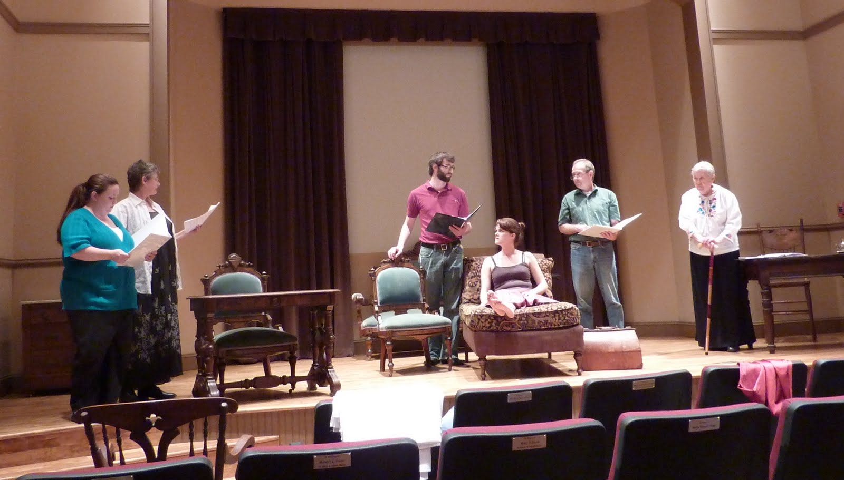
Blocking
stage movements and positions that the director works out with the actors in rehearsal.
https://www.youtube.com/watch?v=RsE4AGxWL1I

Slide 11
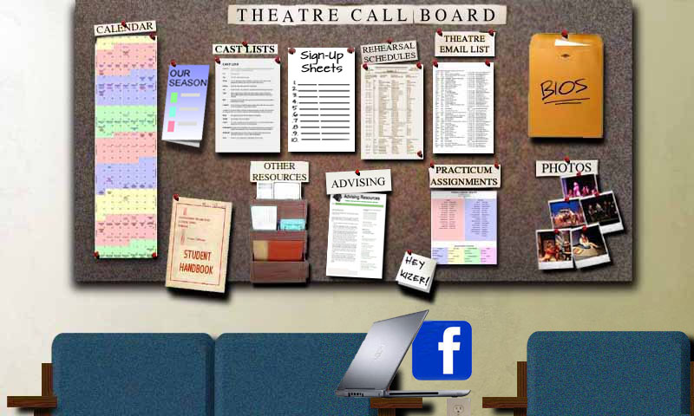
Call
a notification to cast and crew of a rehearsal or performance.

