Slide 1
Vocab Week 10
S-V

Slide 2
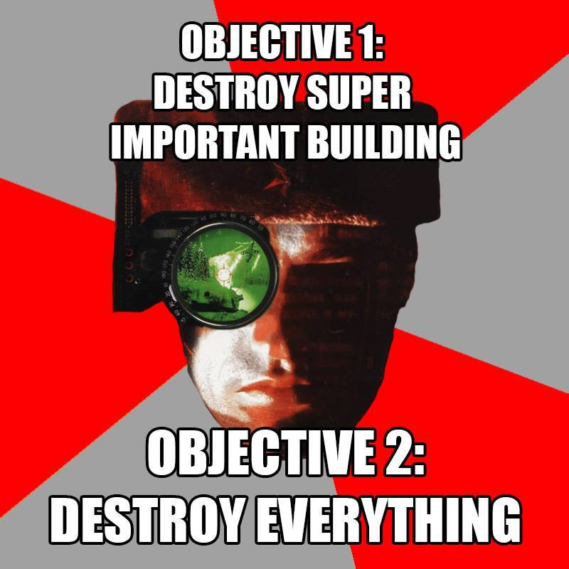
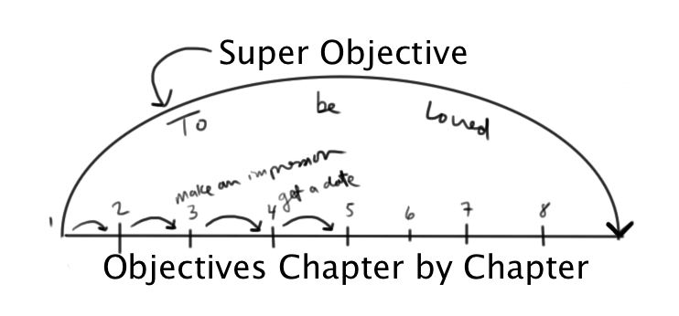
Super Objective
a character’s ultimate goal in the entire play

Slide 3
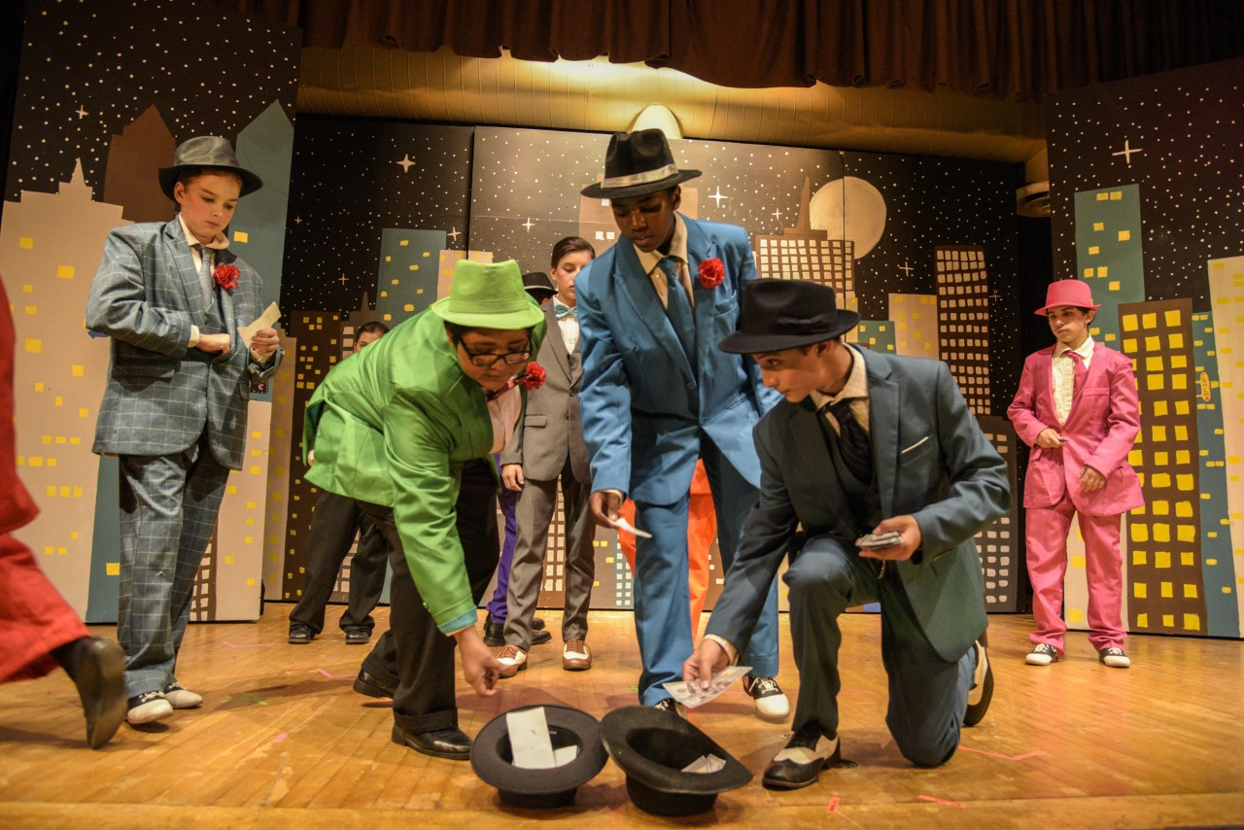
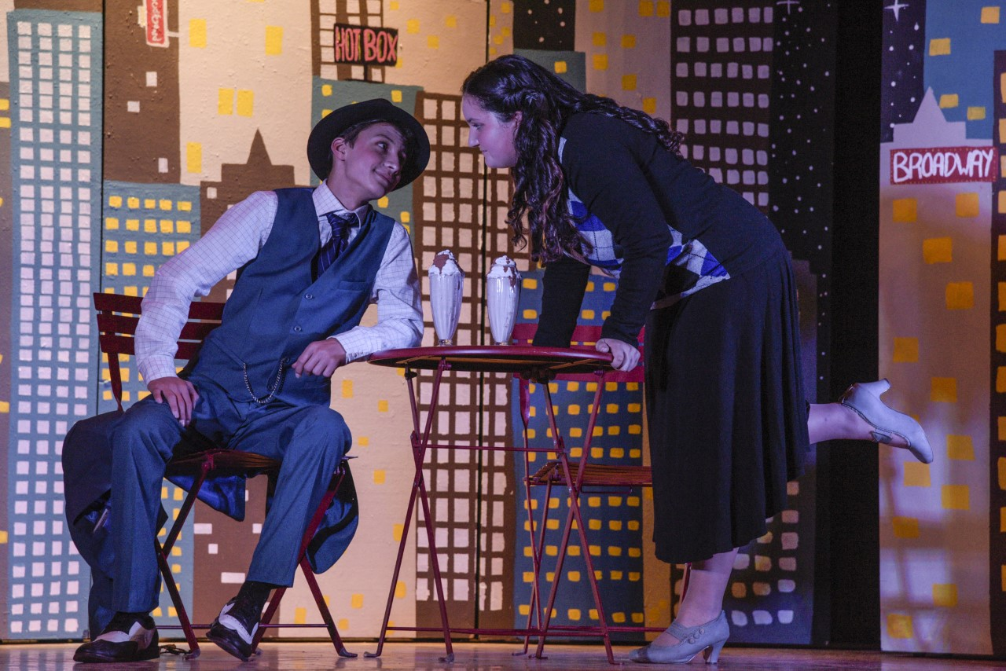
Tableau
a silent and motionless depiction of a scene created by actors

Slide 4
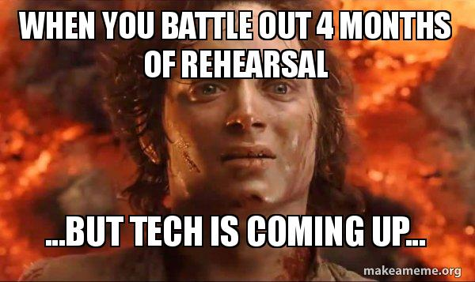
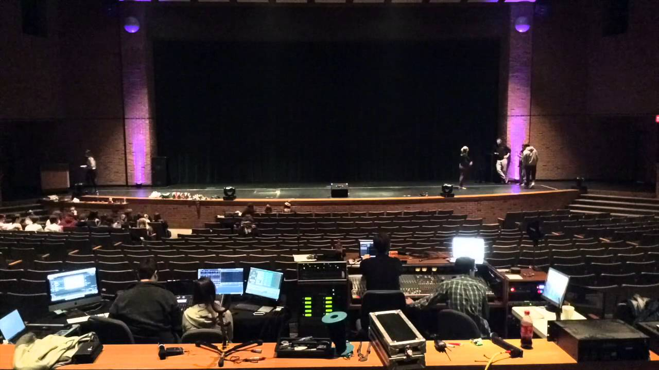
Tech Rehearsal
rehearsal that focuses on the technological aspects of the performance. It runs through the entire production, either in its entirety or cue-to-cue.

Slide 5
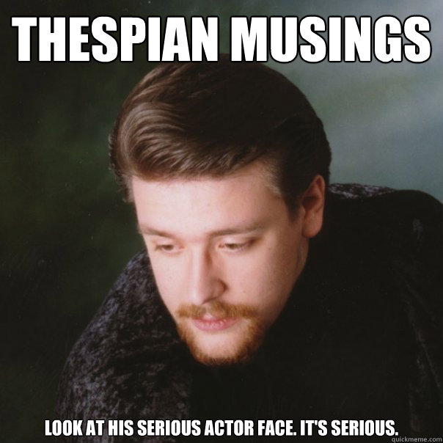
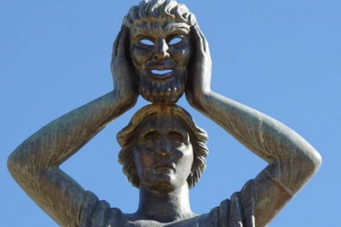
Thespian
the official word for an actor, based on the first actor from Greece Thespis.

Slide 6
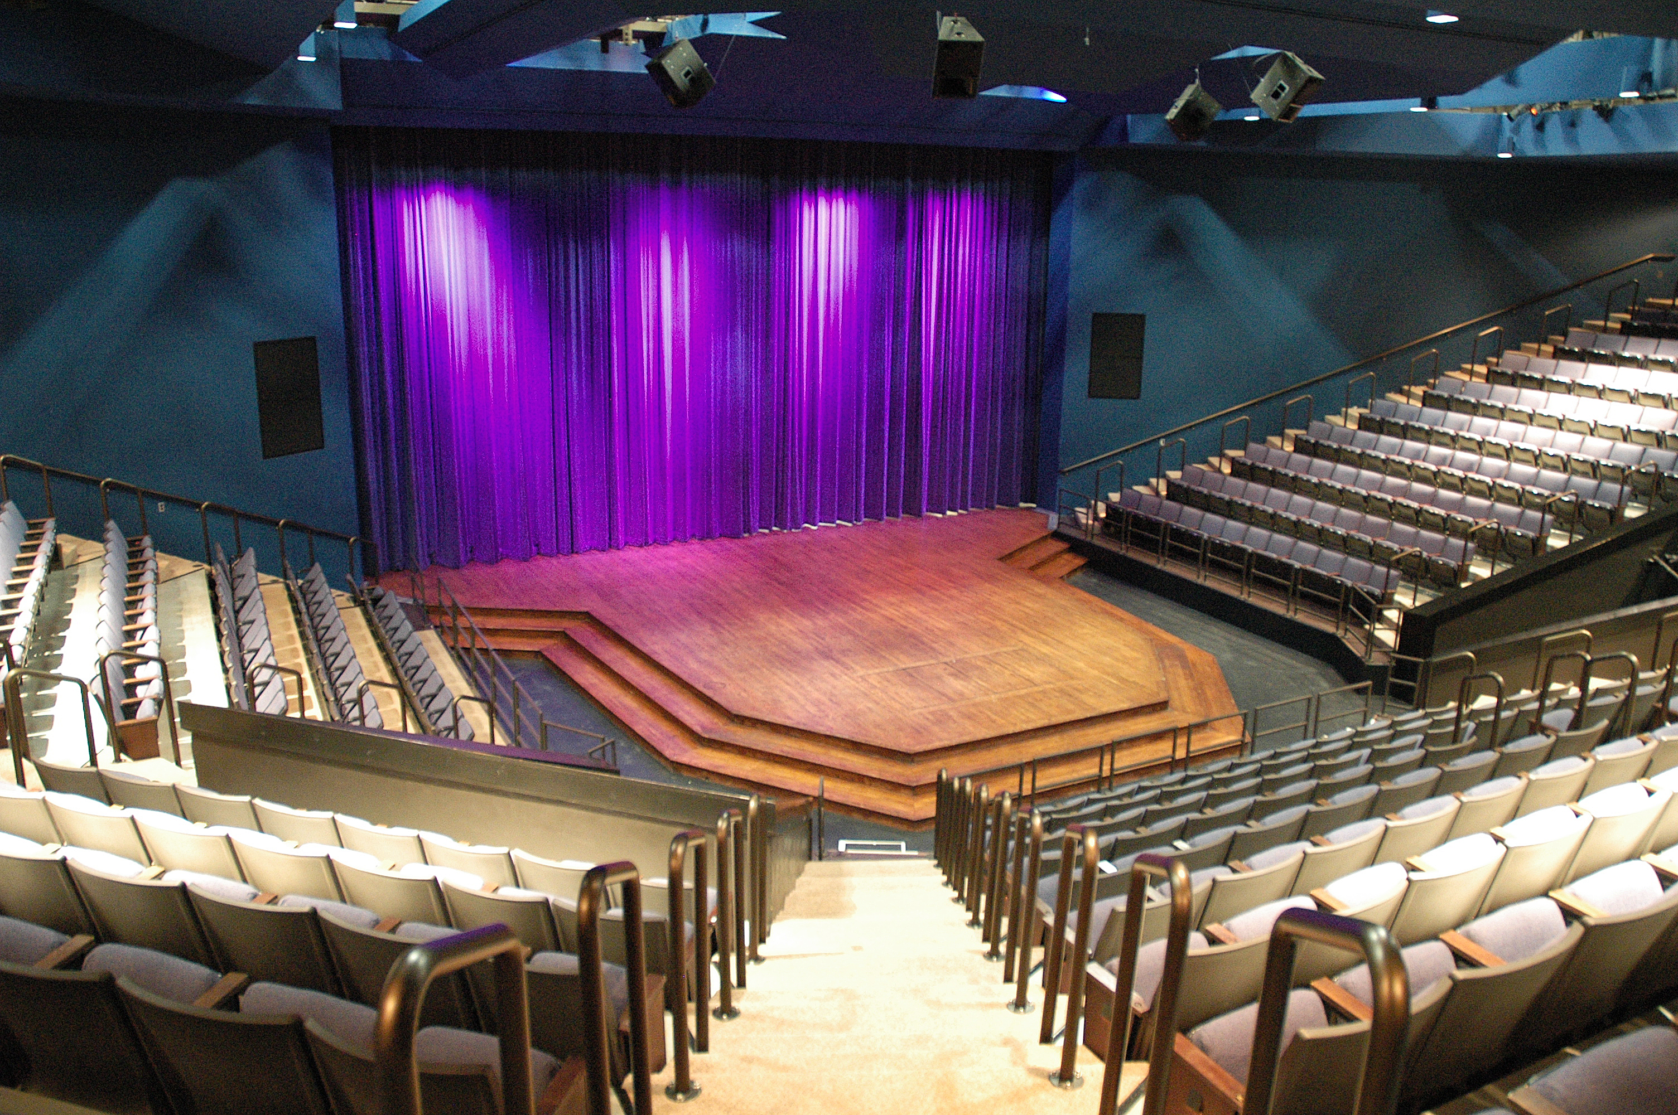
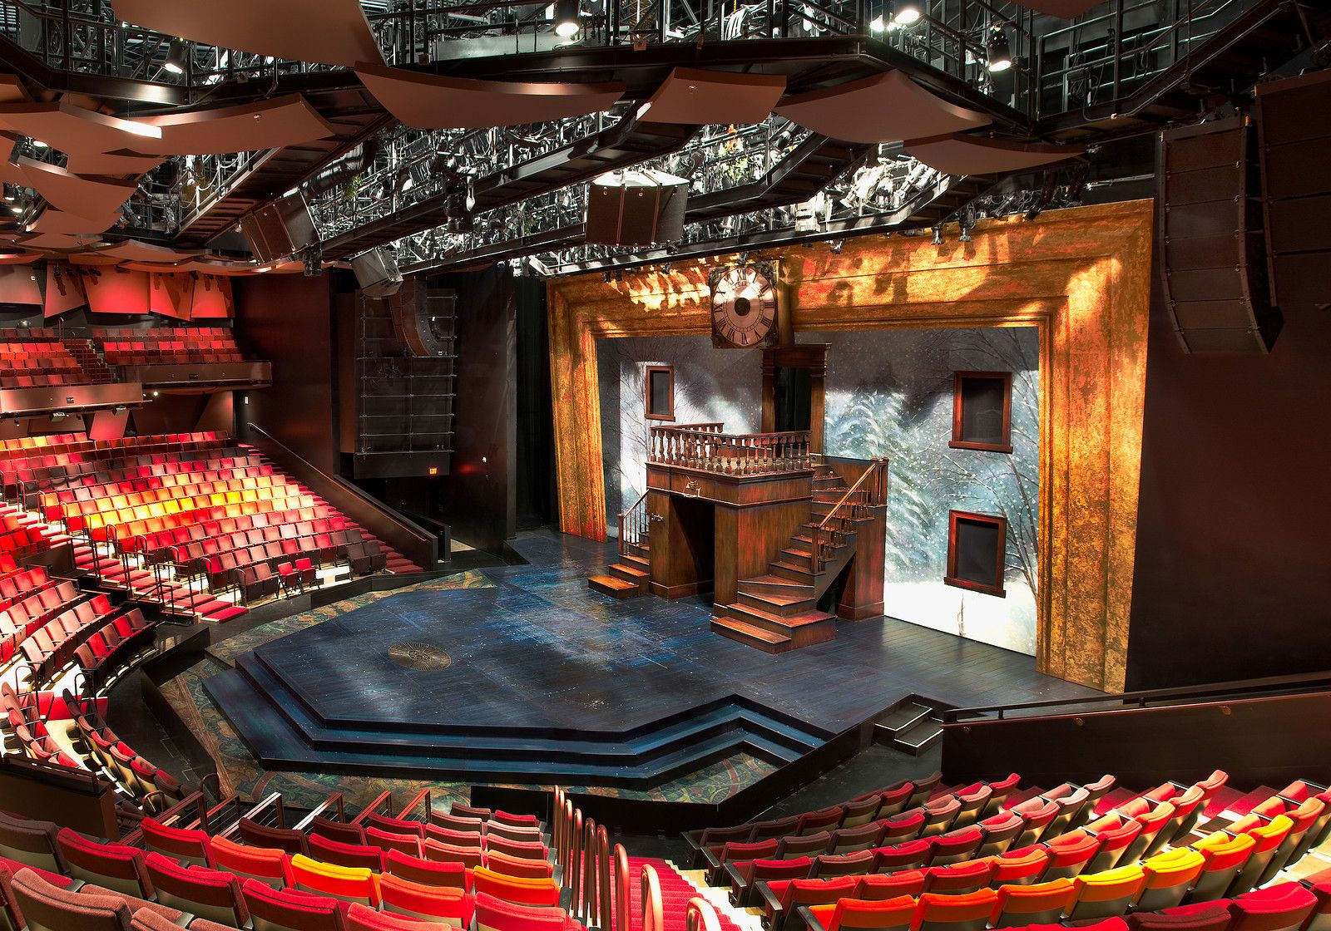
Thrust
part of the stage that extends into the audience

Slide 7
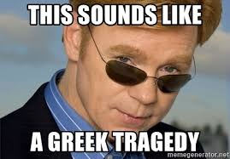
Tragedy
the type of show which focuses on sad themes

Slide 8
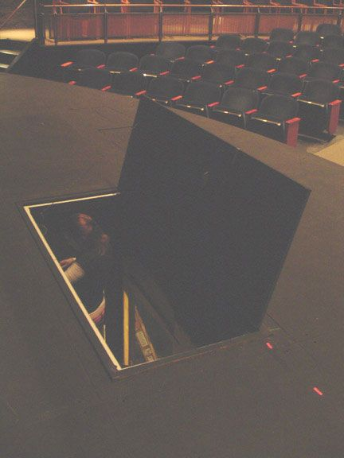
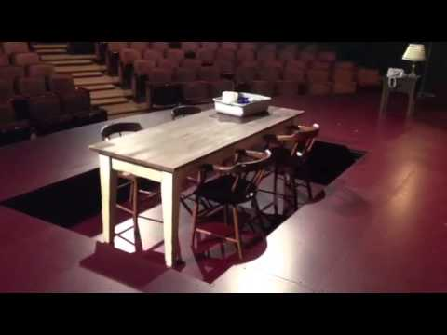
Trap Door
an opening in the stage that allows actors to move below the stage, also known as Hell.

Slide 9
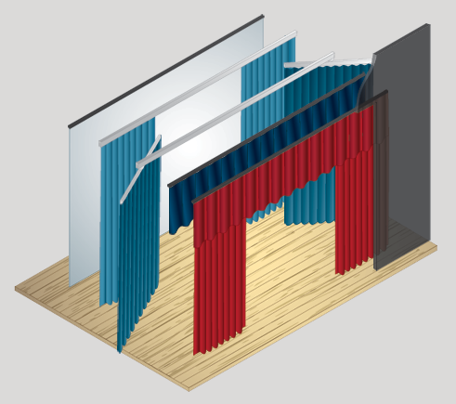
Traveler
is the most common type of curtain. Usually the front, middle and back curtains. Move horizontally to reveal or hide parts of the stage.

Slide 10
Under Contract
when an actor is cast in a show their appearance is considered “owned” by the production company. An actor must not cut their hair, paint their nails, color their hair or change their appearance without permission.

Slide 11
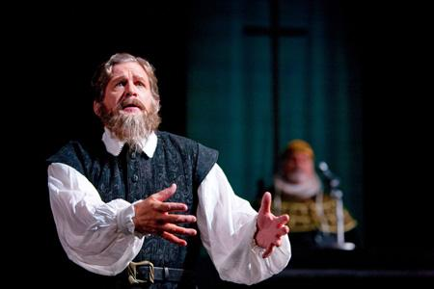
Verbal(s)
the words an actors uses

