Slide 1
Vocab Week 2
C

Slide 2
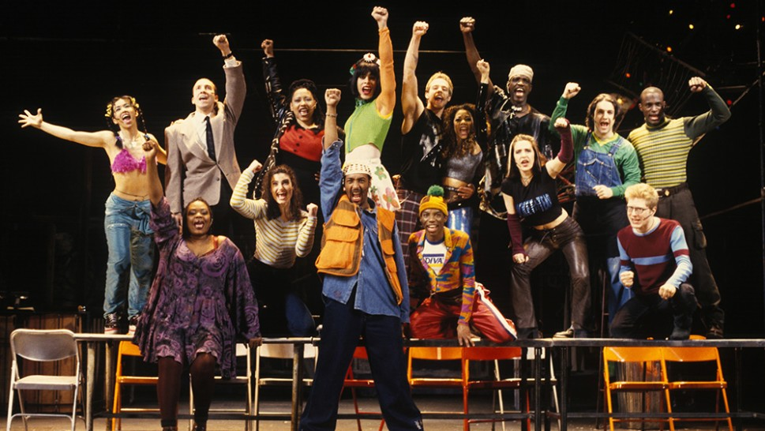
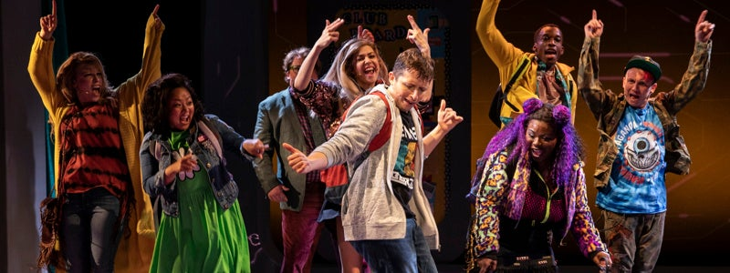
Cast
the troupe of actors in a play.

Slide 3
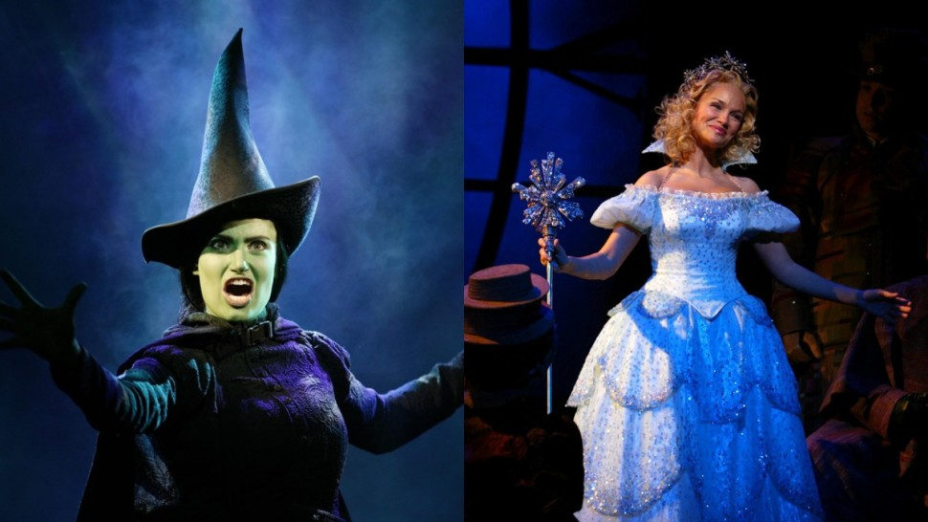
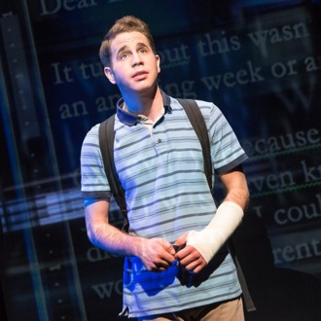
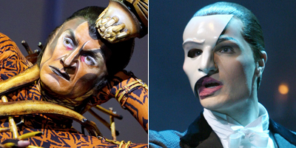
Character
A personality or role an actor re-creates on stage.

Slide 4
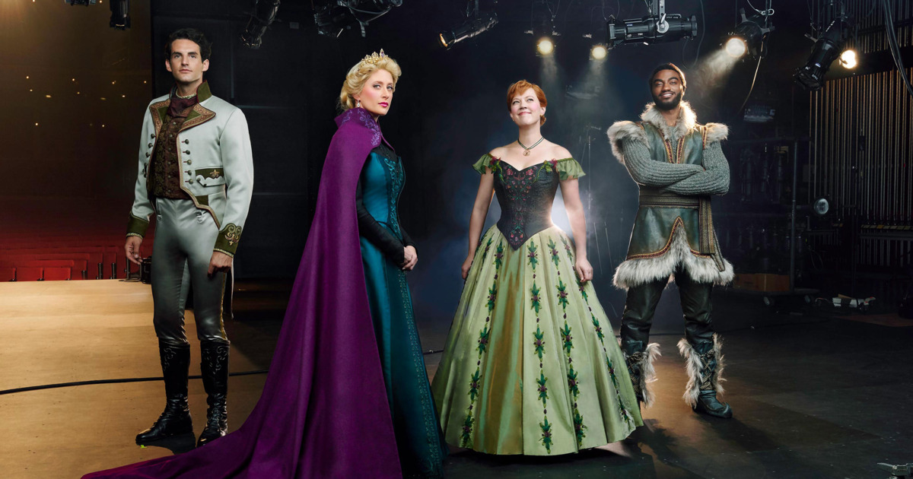
Characterization
the process, development and portrayal of a personality through thought, action, dialogue, costuming and makeup.

Slide 5
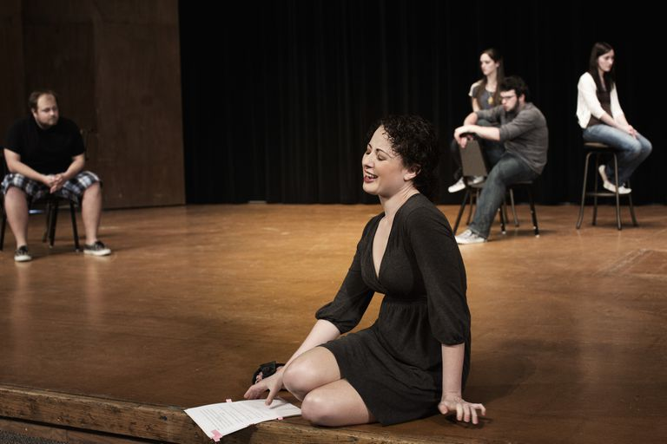
Cheating
automatic placement of an actor on stage, showing 3/4 of their body

Slide 6
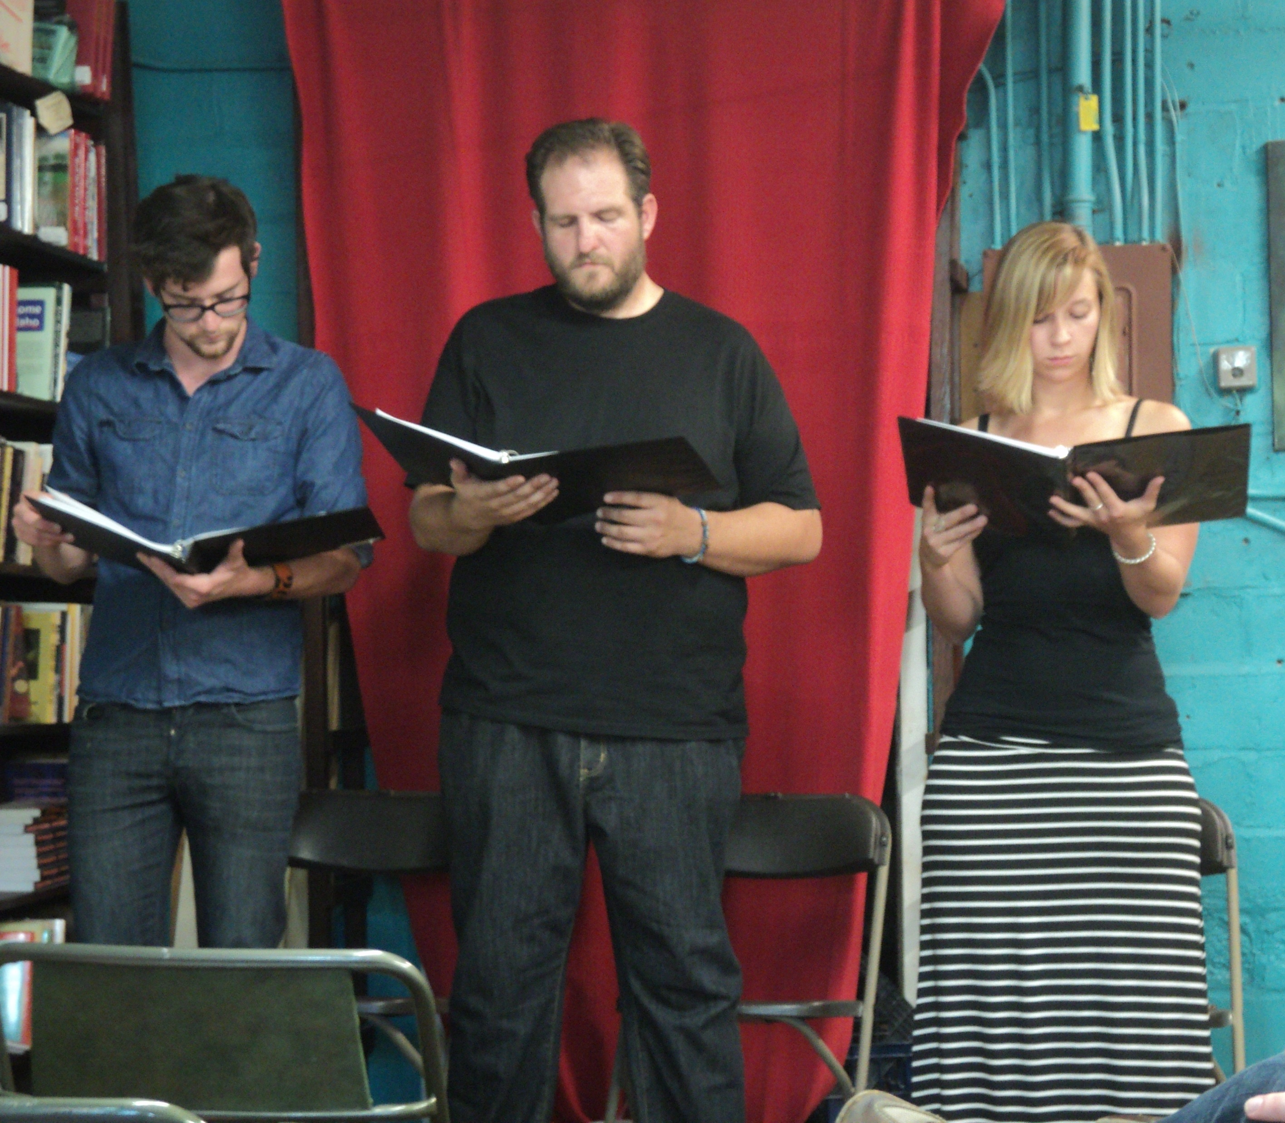
Cold Reading
a reading of a script done by actors who have not previously reviewed the play. Also used for auditions. Actors are expected to read scenes “cold”.

Slide 7
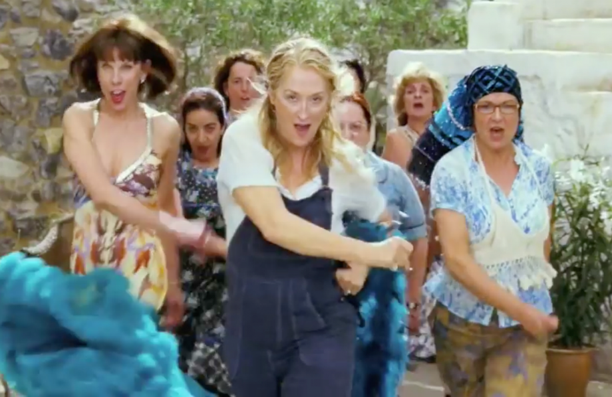
Comedy
a theatrical work that is humorous.

Slide 8
Company
An organization of performers and associated personnel who put on plays.

Slide 9
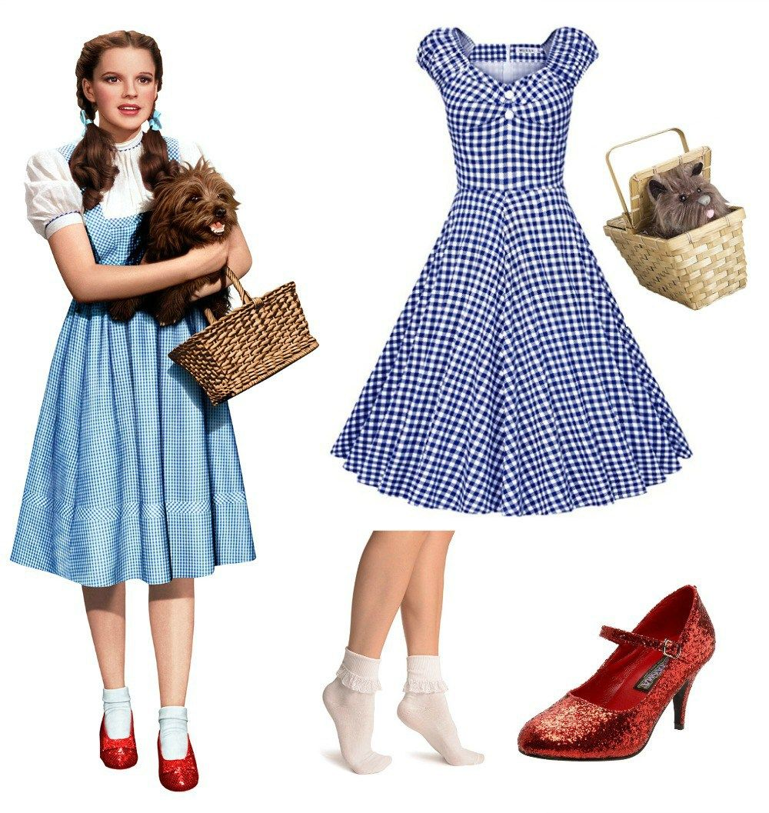
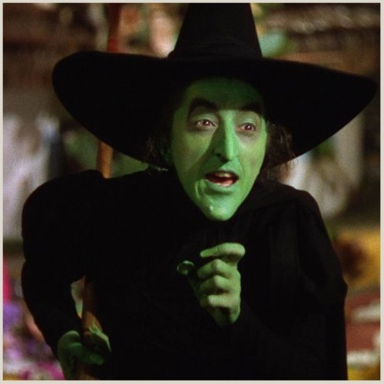
Costume
the clothing an actor wears to evoke the appearance of a particular character.

Slide 10
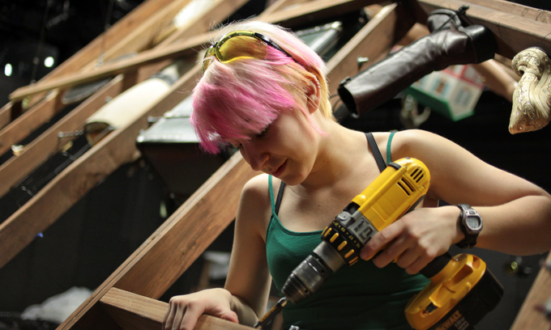
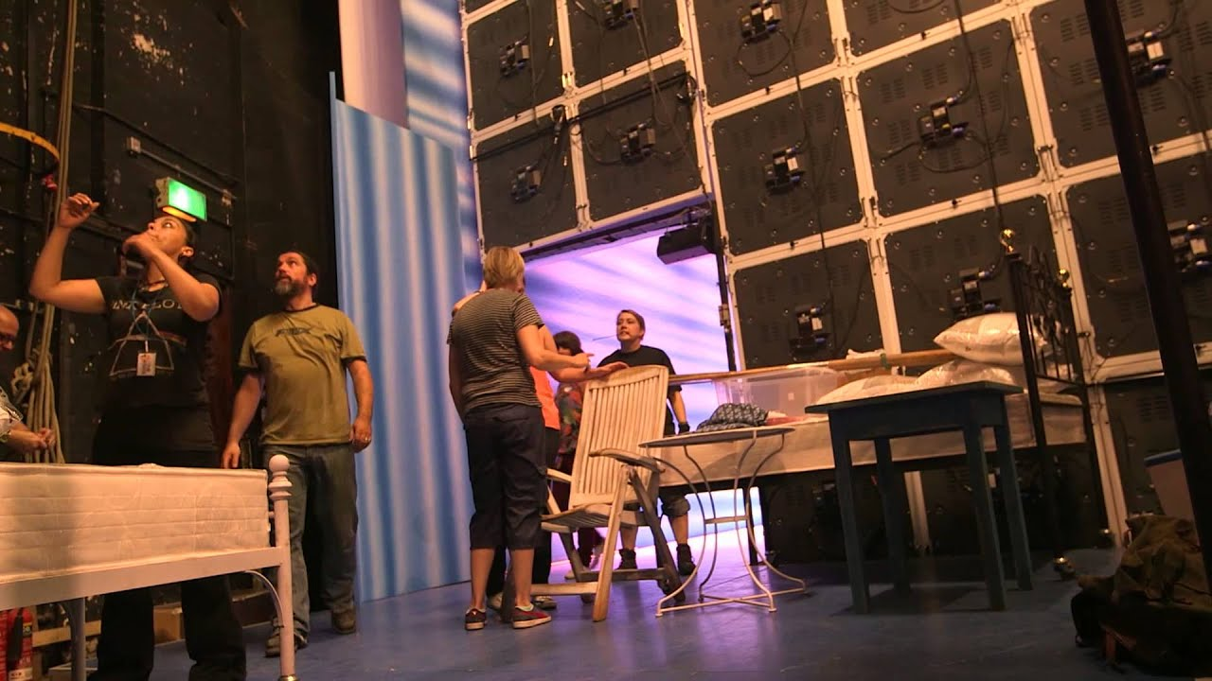
Crew
the team of theatre workers who take care of the physical aspects of a production such as set, lights, sound, etc.

Slide 11
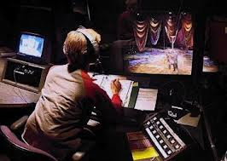
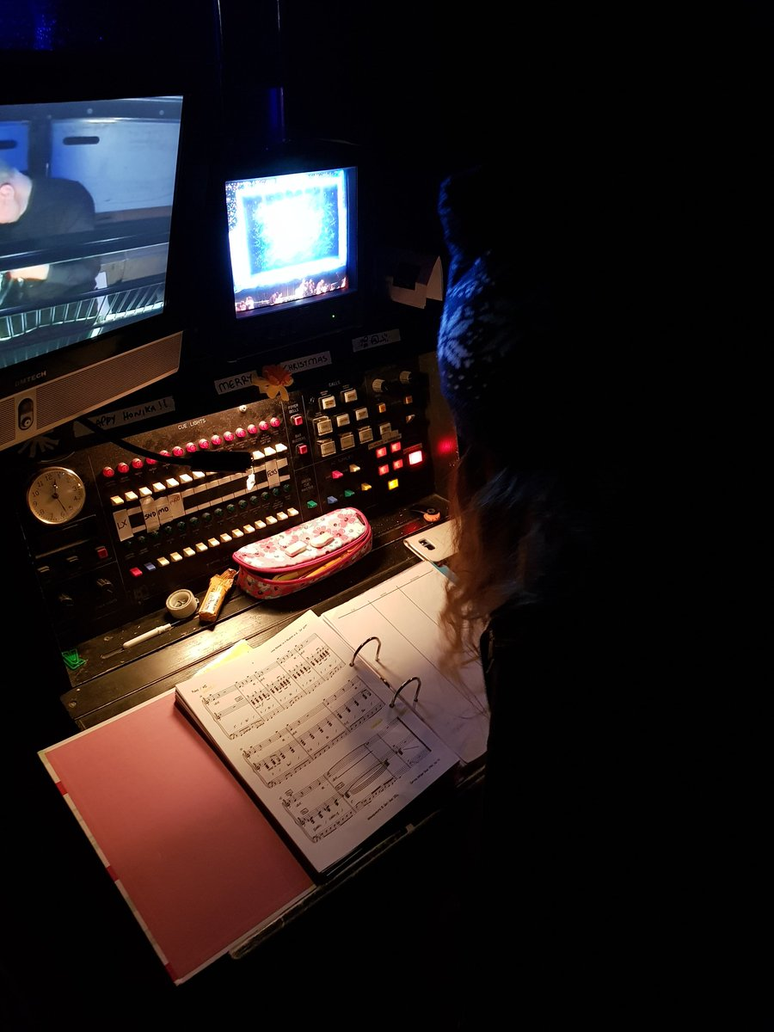
Cue
a prearranged sign that indicates it is time to proceed to the next line or action.

