Slide 1
Vocab Week 3
C-E

Slide 2
Cue-to-Cue Rehearsal
rehearsal when the sound and lights are run with certain parts of scenes within the production.

Slide 3
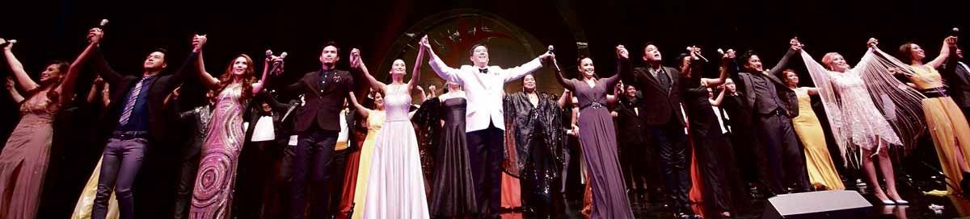
Curtain Call
at the end of the play when the performers acknowledge the audience’s applause and bow.

Slide 4
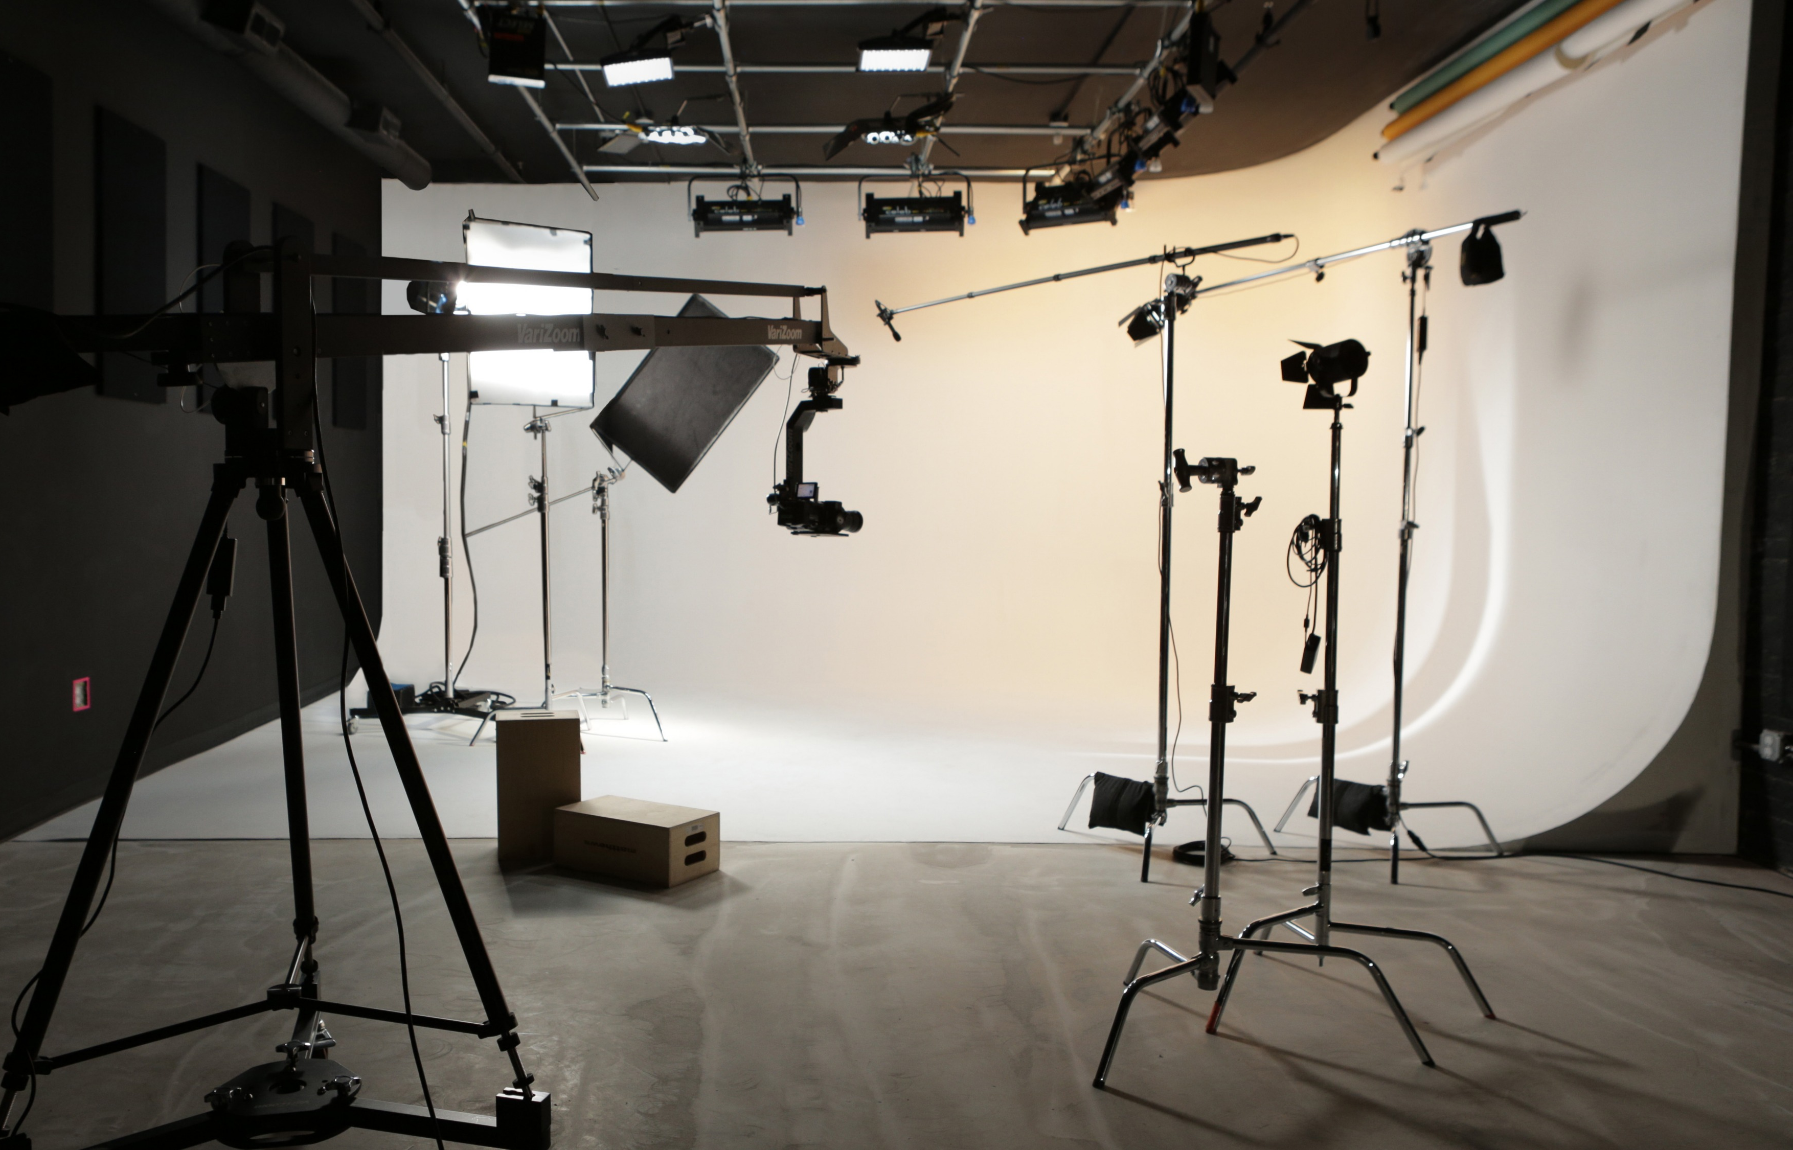
Cyclorama (cyc)
background device employed to cover the back of the stage and used with special lighting to create the illusion of sky, open space, or great distance.

Slide 5
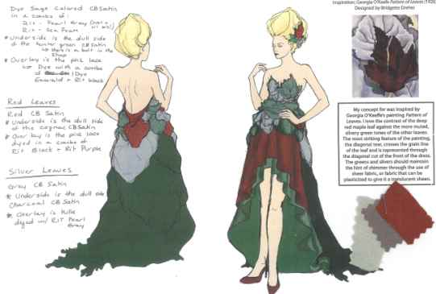
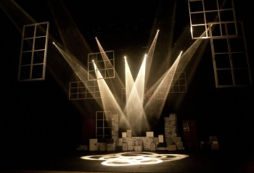
Design
the creative process of developing and executing the look of a show such as costuming, set, and lights.

Slide 6
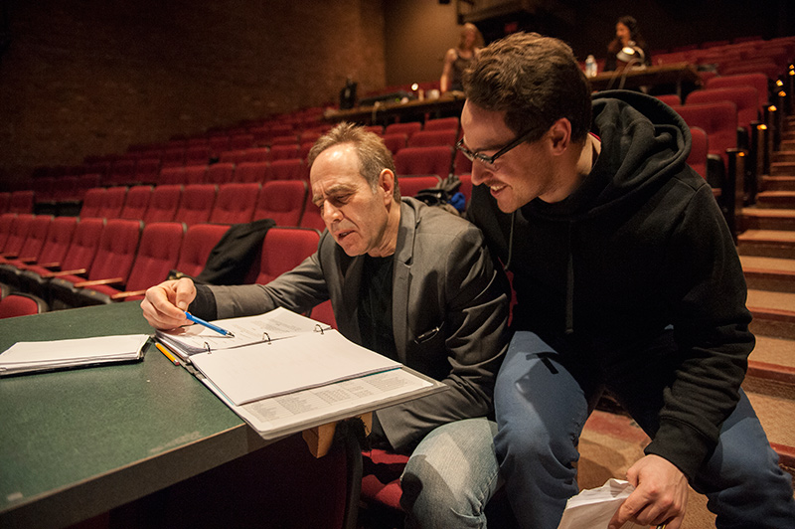
Director
the major interpretive figure, the artistic visionary whose job it is to bring to life the playwright’s script. The director’s primary objective is to provide artistic meaning to the theatre experience. (God)

Slide 7
Down/Up
words used to indicate the stopping/starting of a cue or indicate a direction

Slide 8
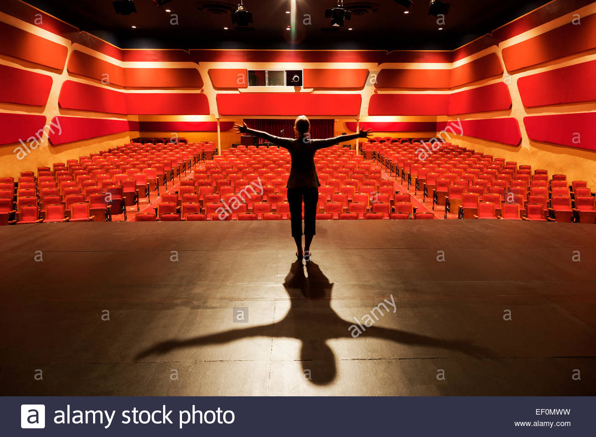
Downstage/Upstage
the part of the stage closest to the audience as you face the audience and the part of the stage closest to the backwall.

Slide 9
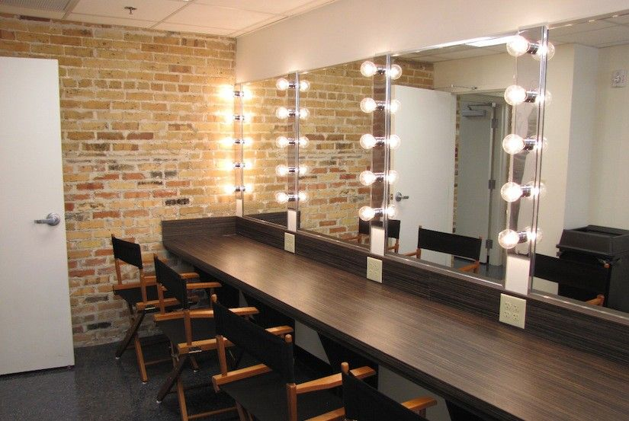
Dressing Room
a space for performers to hang costumes, put on makeup, and otherwise prepare for their show

Slide 10
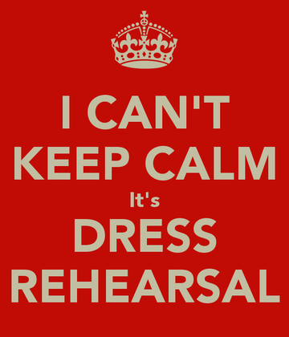
Dress Rehearsal
final rehearsal in which all visual elements of production, including costumes, are used.

Slide 11
Emotional Memory
the technique of calling on your own memories to understand a character’s emotions.

