Slide 1
Vocab Week 4
E-F

Slide 2
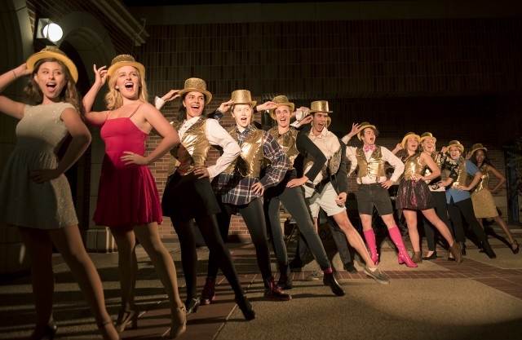
Ensemble
sense of “family” unity developed by a group of performers during the course of a play; the willingness of actors to subordinate themselves to the production as a whole

Slide 3
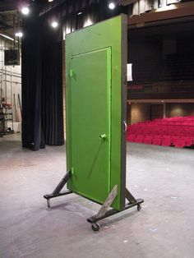
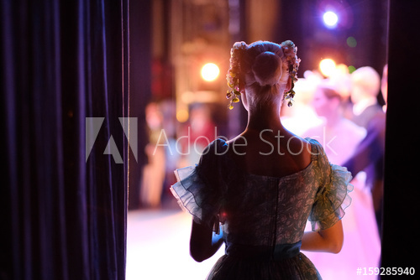
Entrance/Exit
Both are noun and verb. Any place an actor can enter or exit the stage, might be a door, window or an opening between flats. Also known as the physical entering and leaving of the stage.

Slide 4
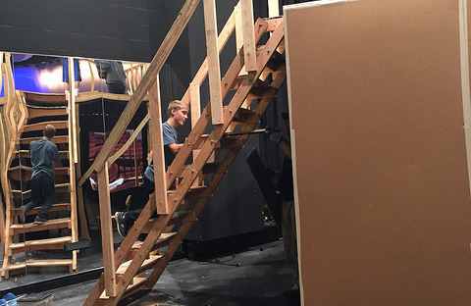
Escape Stair
any staircase out of the audience's view that is used to help actors get off the set

Slide 5
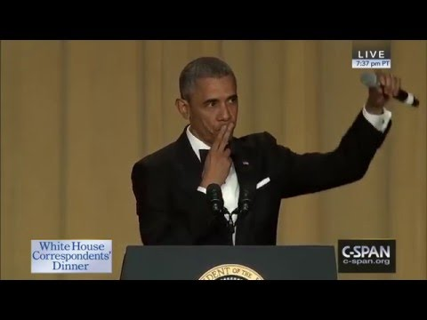
Exit Line
a line delivered just before or just as an actor leaves the stage

Slide 6
Fast Change (Quick Change)
a costume change that must be done very quickly, and is therefore done in the wings instead of in the dressing room

Slide 7
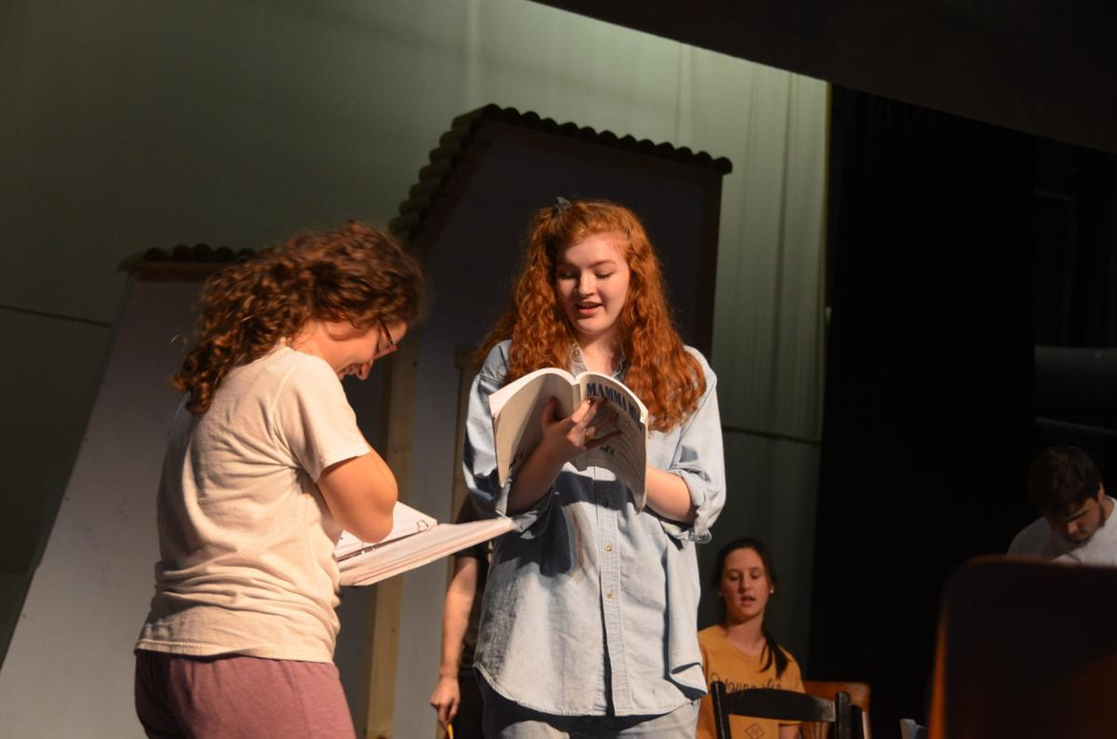
Feed Lines
deliberately given so that the responding actor can get the maximum effect out of his return line

Slide 8
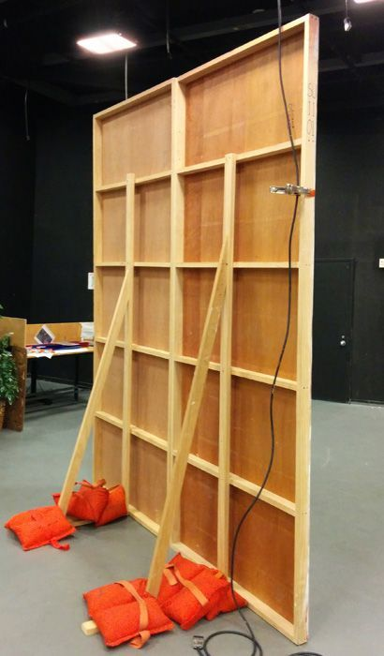
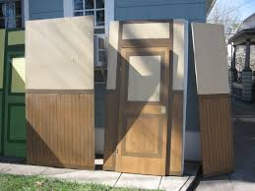
Flat
frame constructed of 1-by-3 boards, covered with canvas, painted, and used most often for interior or exterior walls of a building in a stage setting

Slide 9
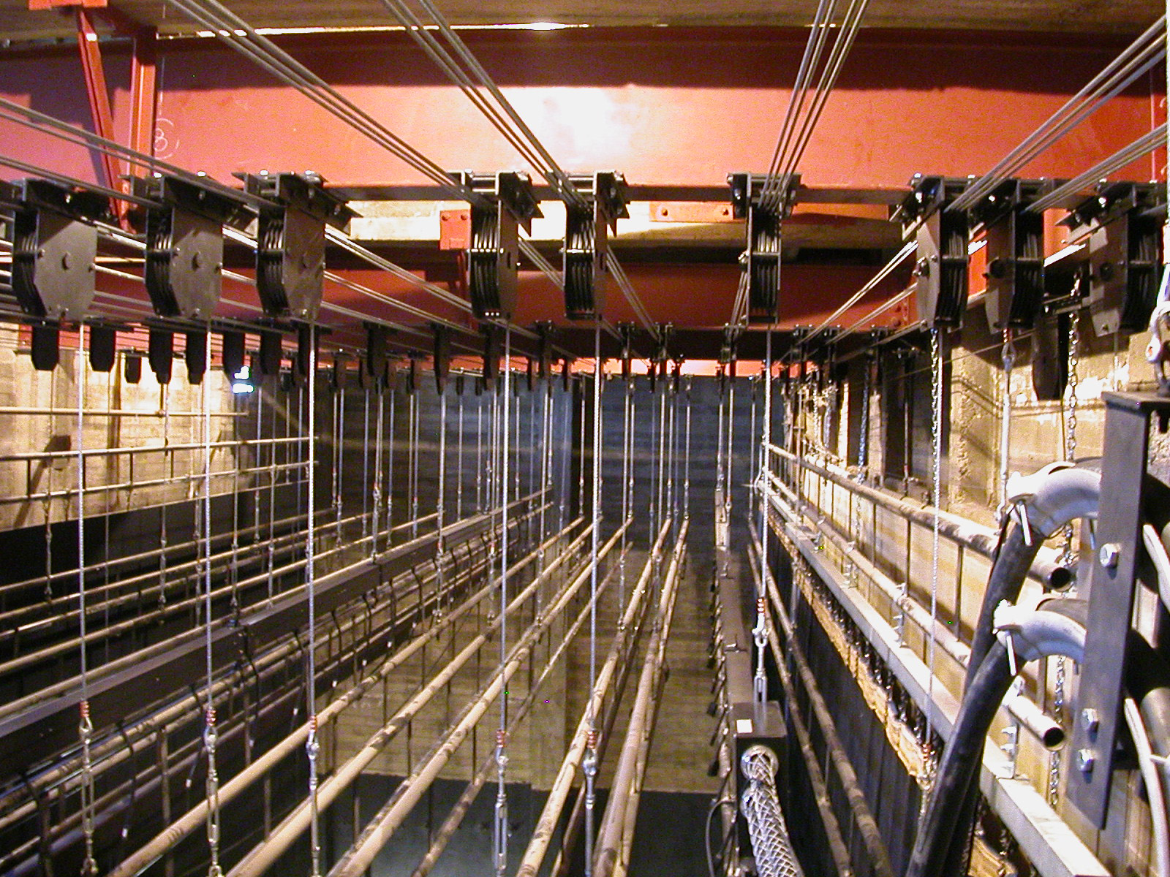
Fly Gallery
the area above the floor level of the stage used for tying fly lines and flying actors who wear harnesses for safety

Slide 10
Focus
controlling the audience’s attention. A director may have to ask an actor not to steal focus with excessive movement on another actor’s line.

Slide 11
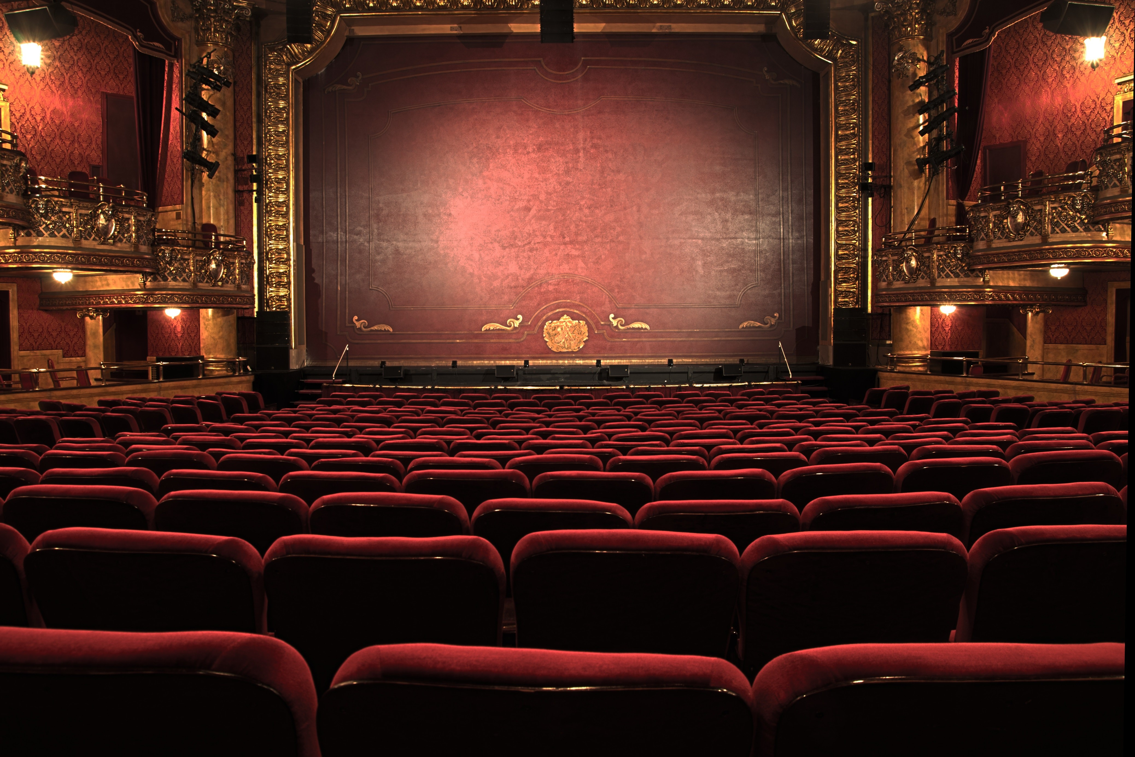
Fourth Wall (Curtain)
imaginary wall filling in the proscenium arch through which the audience can see in and observe the action

