Slide 1
Vocab Week 5
F-H

Slide 2
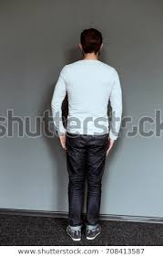
Full Back
performer has his/her back to the audience

Slide 3
Full Front
performer is facing the audience

Slide 4
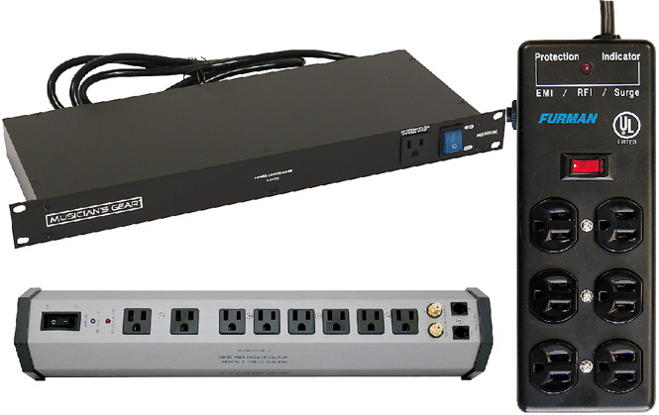
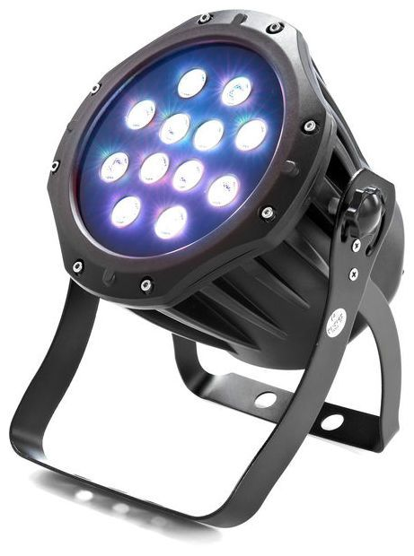
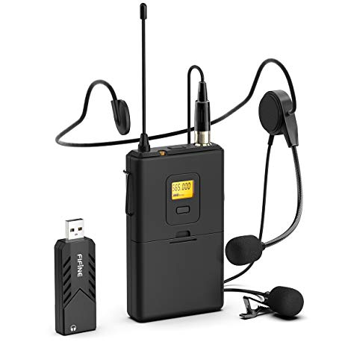
Gear
the equipment used by sound or lighting.

Slide 5
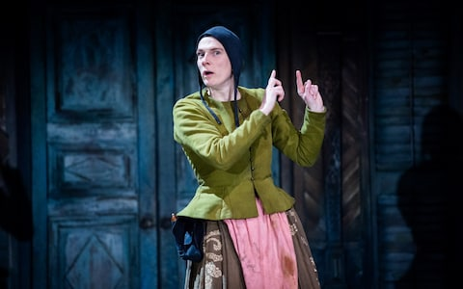
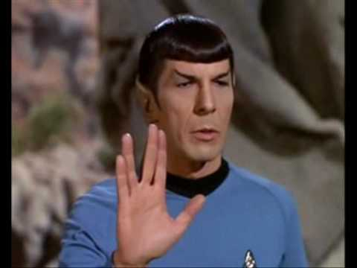
Gesture
the use of hand, body and facial movement to make the actor’s dialogue more meaningful or to make a point without dialogue, always above the waist

Slide 6
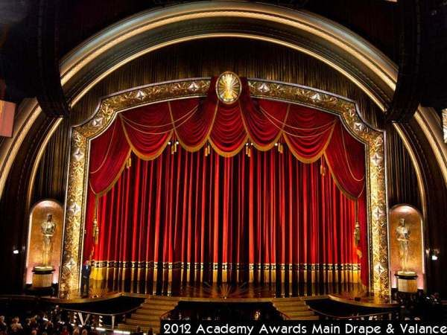
Grand Drape
The front curtain, which is behind the proscenium arch. It is typically opened and closed during performances to reveal or conceal the stage and scenery from the audience.

Slide 7
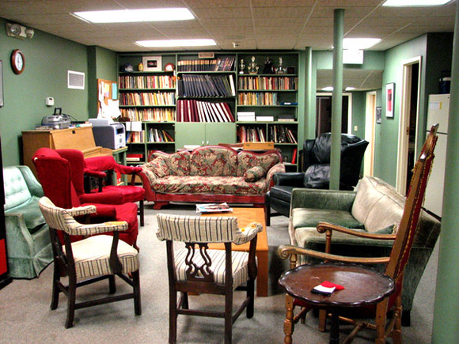
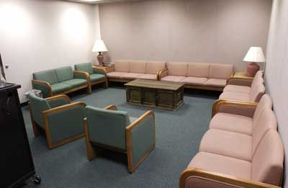
Greenroom
traditional name of the room in which actors gather to wait for entrances and hear announcements

Slide 8
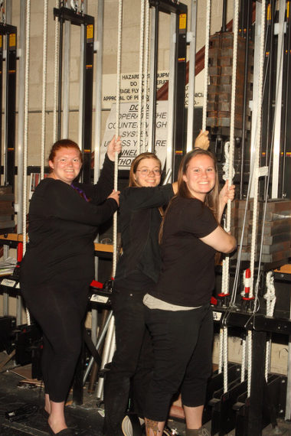
Go
word used by crew only to indicate the starting of a technical cue such as lights, sound set changes.

Slide 9
Go Dark
this term has two meanings: call for a blackout and/or the temporary closing of a show between run weeks. For example: a show runs Friday through Sunday it is typically said to “go dark” between Monday and Thursday.

Slide 10
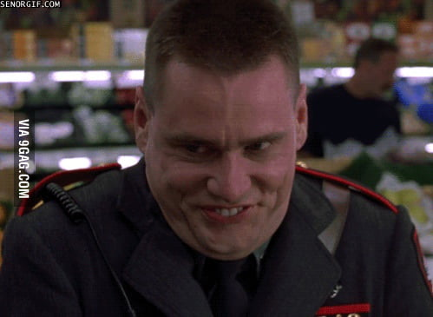
Hold
to pause for laughter or applause to die down or to wait for the scene to start again.
https://www.youtube.com/watch?v=sXNBXxUOpmk

Slide 11
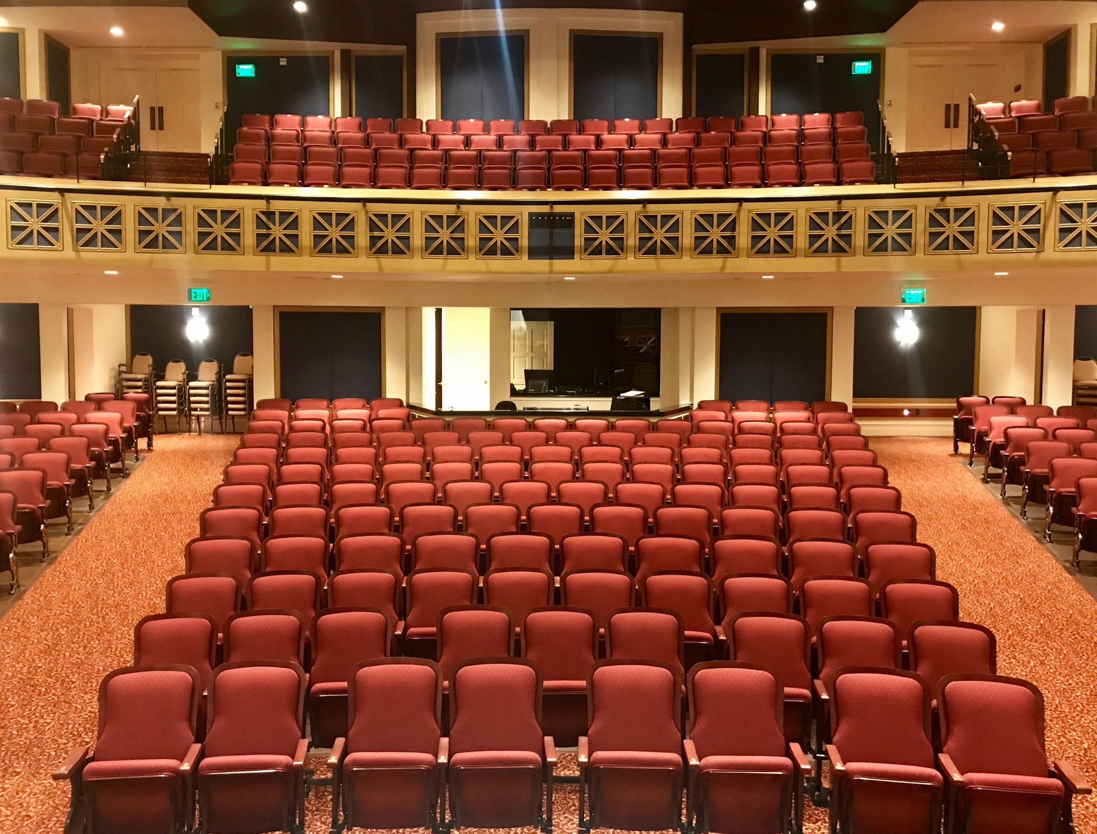
House
rows of seats in which the audience sits to watch a performance

