Slide 1
Vocab Week 6
H-L

Slide 2
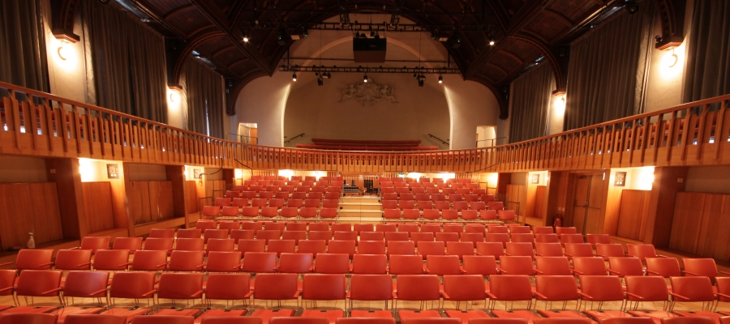
Houselights
lights that illuminate the auditorium of a theater; all the lights in the auditorium except the “exit” lights. These lights usually dim and are controlled from the light booth

Slide 3
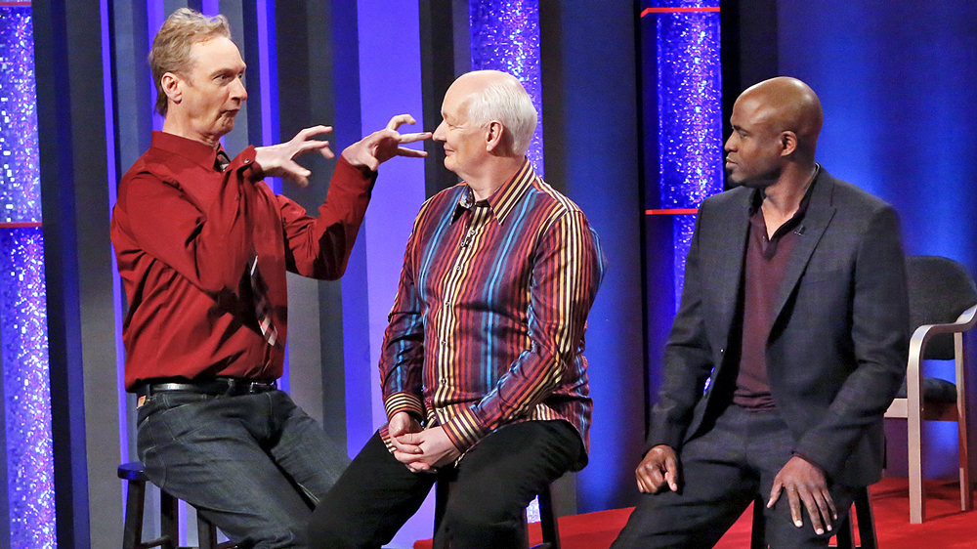
Improvise (Improv)
to ad lib or invent dialogue not in the script

Slide 4
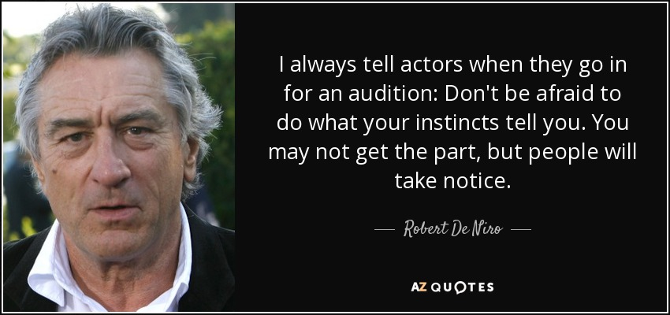
Instincts
the feeling an actor has to perform a movement or reaction
https://www.youtube.com/watch?v=z67edNpn1zs

Slide 5
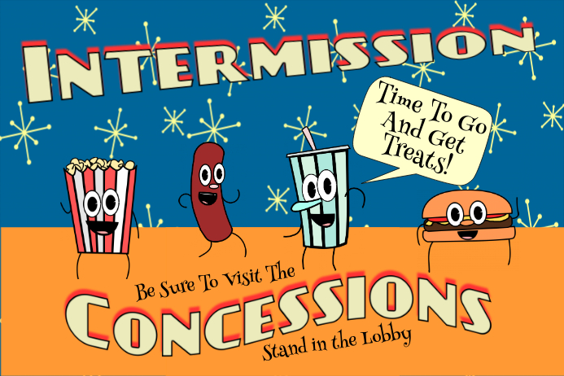
Intermission
intervals between the acts or scenes allowing for set changes, costume change, etc. Usually 10-15 minutes.
https://www.youtube.com/watch?v=lPseOafBEo0

Slide 6

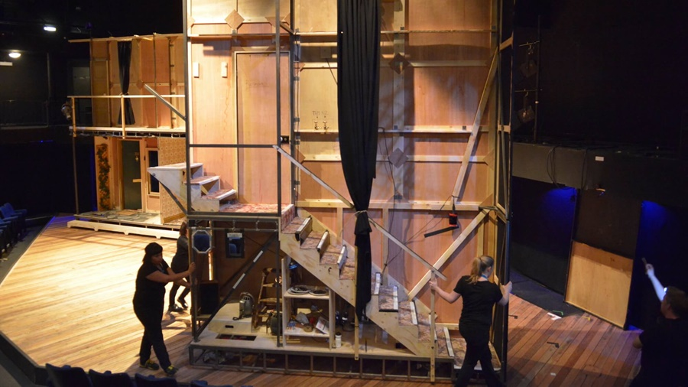
Kill
to remove a prop or set piece permanently from the show

Slide 7
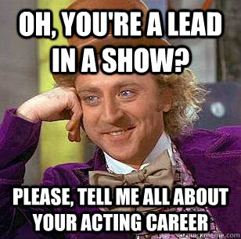
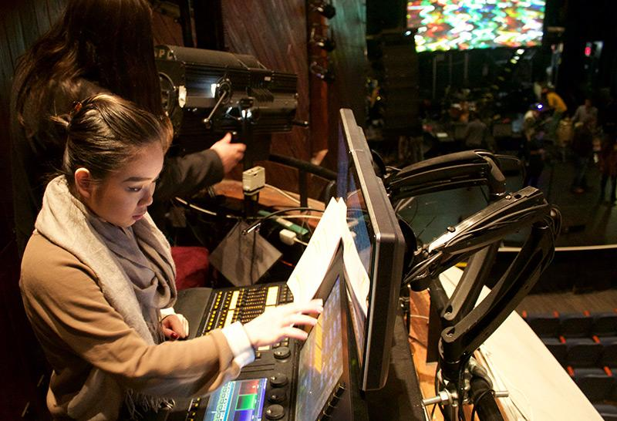
Lead
the starring role in a performance or the head of a crew

Slide 8
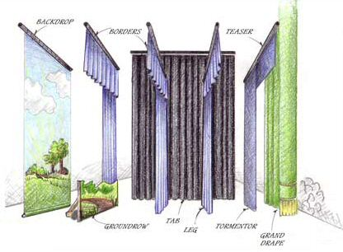
Legs
tall, narrow stage drapes that are used to mask the wings on either side of the stage.

Slide 9
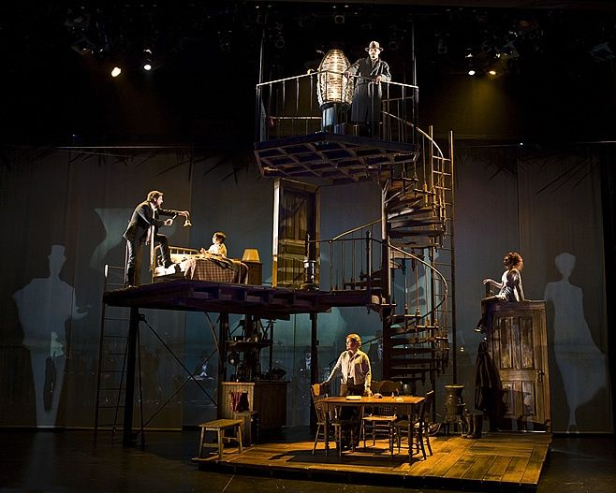
Levels
steps, platforms etc., that raise the actor from the stage, or when an actor sits or kneels

Slide 10
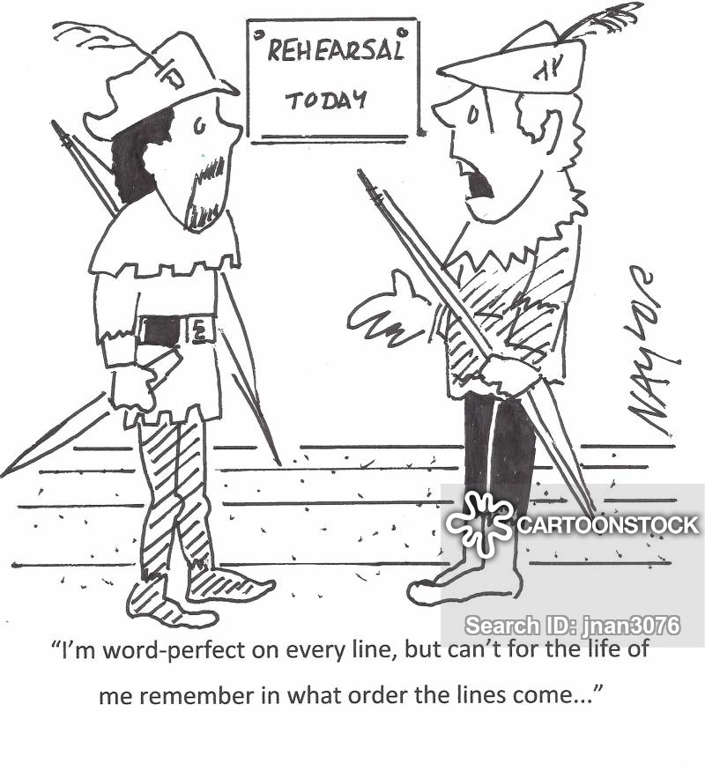
Line Rehearsals
actors are expected to be “off book” and line perfect when these rehearsals are called.

Slide 11
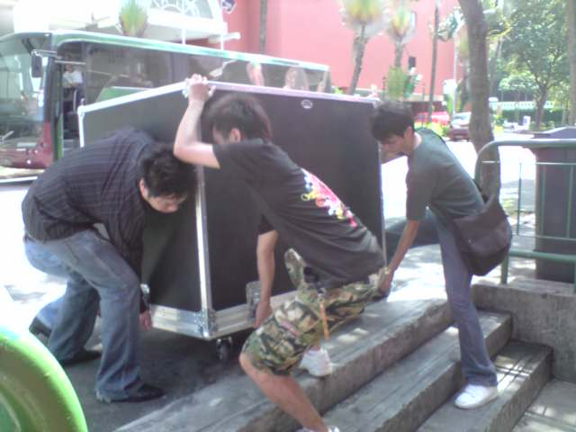
Load in/out
the moving in or out of the set for performances
https://www.youtube.com/watch?v=bPp9uFNX7h0

