Slide 1
Vocab Week 7
M-P

Slide 2
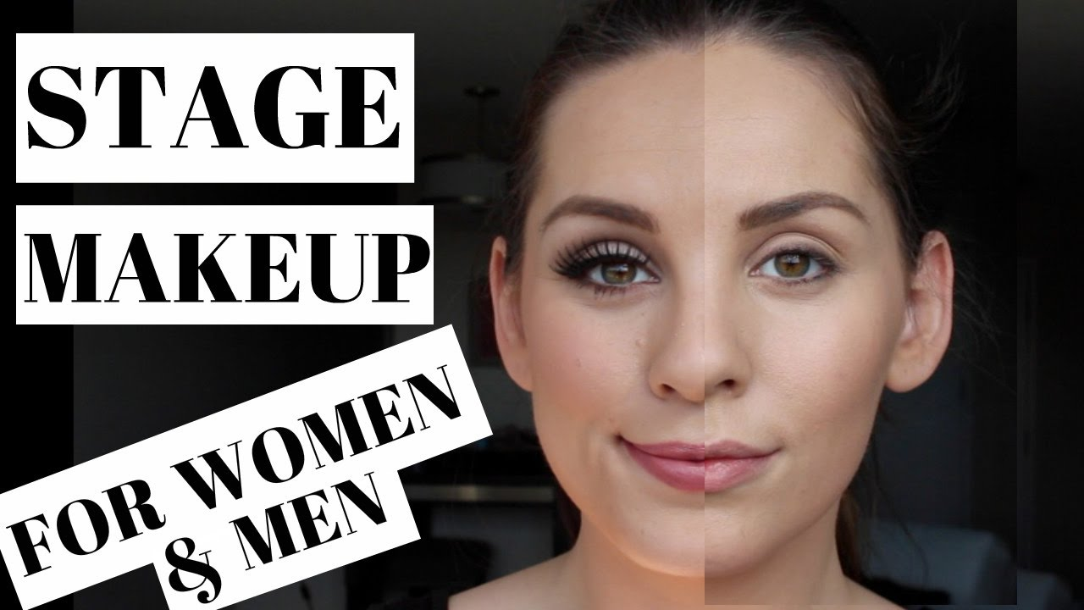
Makeup
covers the face of all actors regardless of gender on stage to be seen through the lights

Slide 3
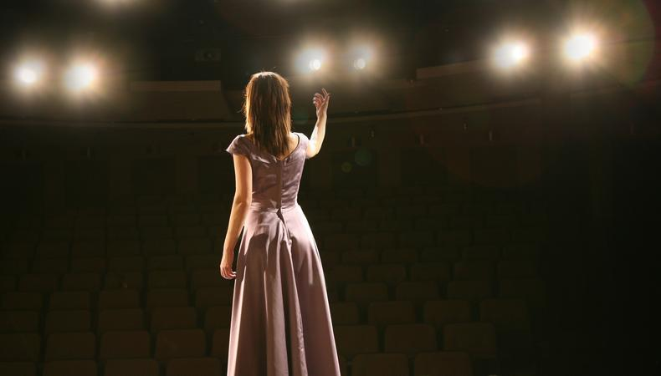
Monologue
uninterrupted speech delivered by one character in a play, use most often for auditions.

Slide 4
Motivation
the reason behind an actor speaking a line or making a movement

Slide 5
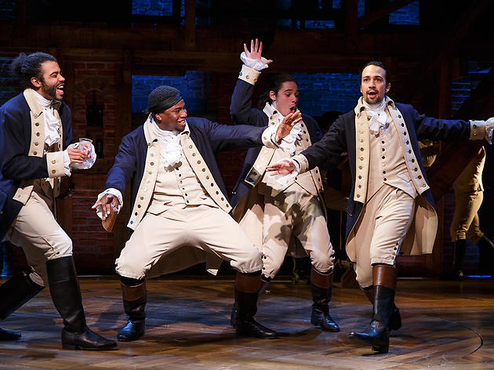
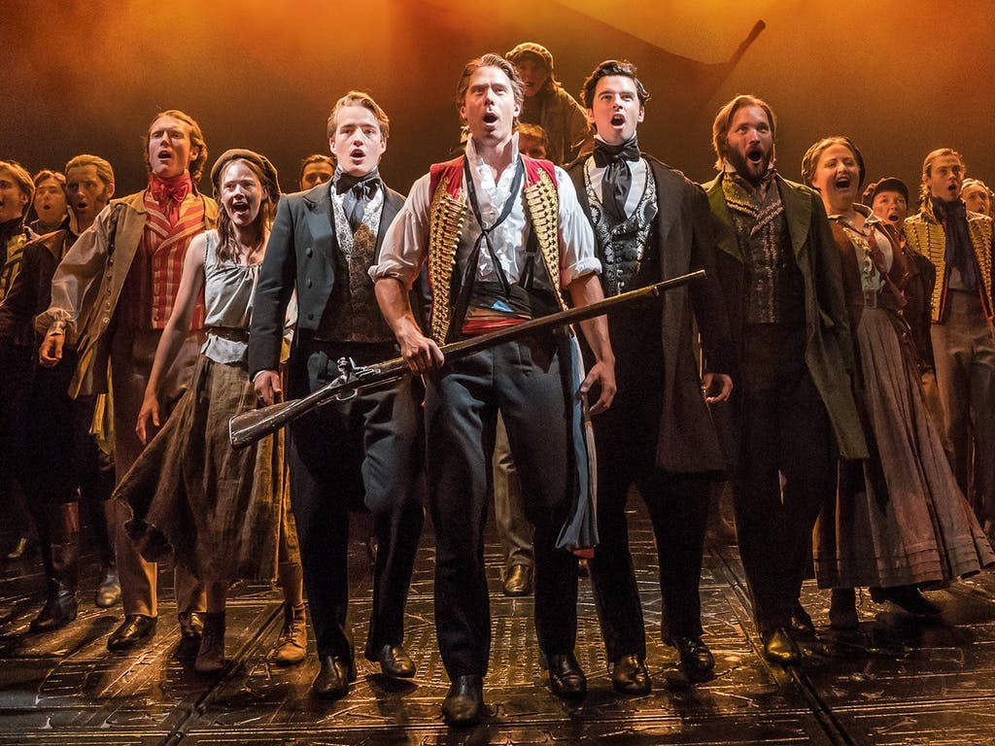
Musical
a play which has singing in it or a play which is primarily singing

Slide 6
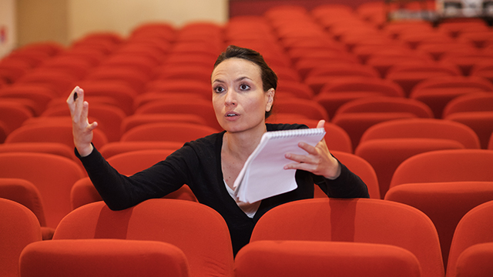
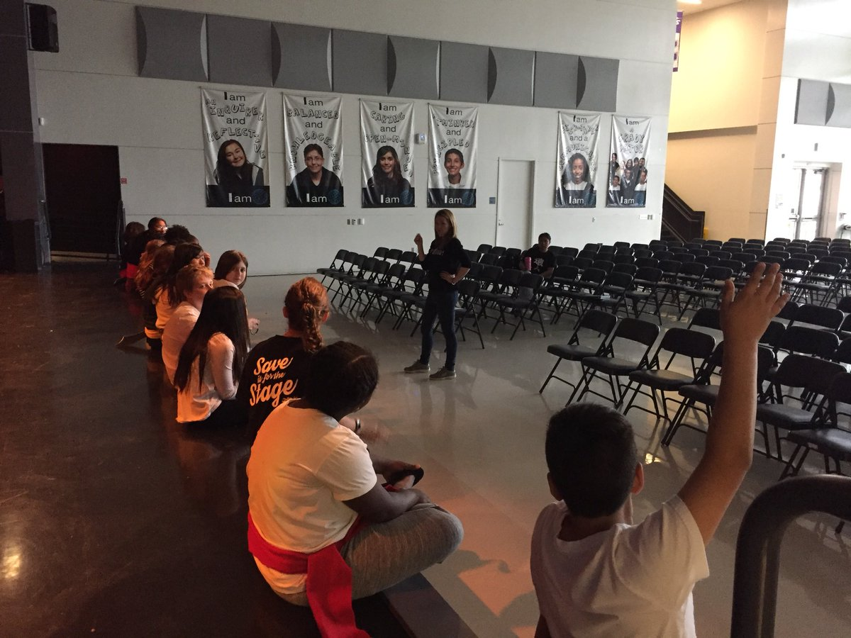
Notes
the corrections written down by the director during a rehearsal and given to the cast either during or after a rehearsal

Slide 7
Objective
the goal every character has in each scene to achieve their Super Objective.

Slide 8
On/Off Book
When “on book” an actor is not memorized. When “off book” an actor is memorized. The stage manager and assistant stage manager following along in the script during rehearsal is also said to be "on book"

Slide 9
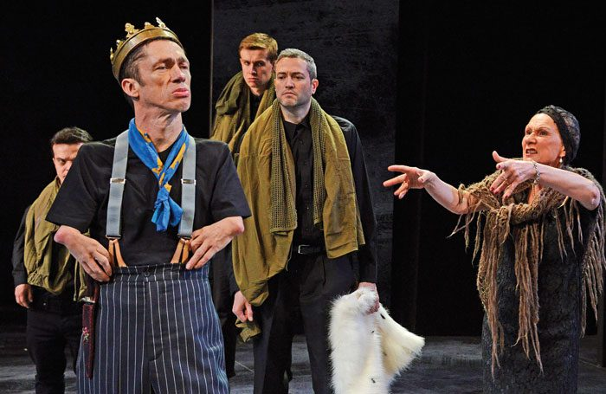
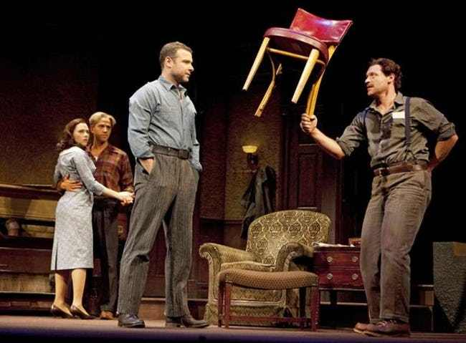
Open/Closed
actor is to turn front and face the audience. When an actor is not cheating or facing the audience.

Slide 10
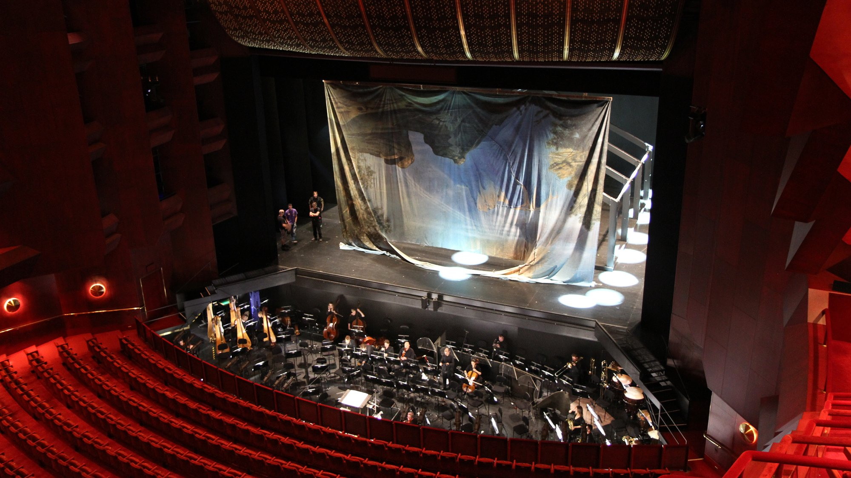
Orchestra Pit
the front part of the stage that can be lowered to provide a playing area for a band.

Slide 11
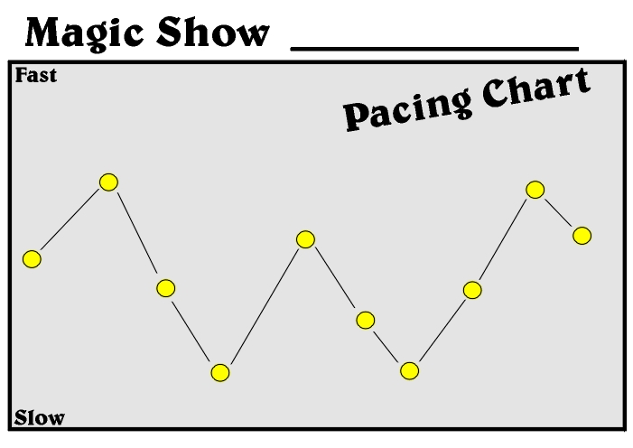
Pacing
rate of performance. Speed is not the only factor of pacing; equally important are intensity, precision, clarity, and frequency of new impressions.

