Slide 1
Vocab Week 8
P-R

Slide 2
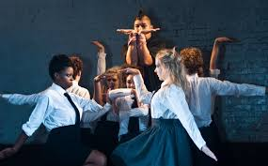
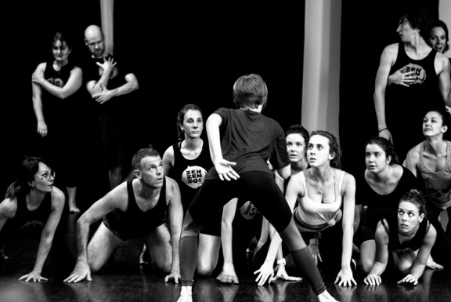
Physical(s)
the ability of an actor to use body movement

Slide 3
Plane
the area on stage where an actor is standing, usually with others.

Slide 4
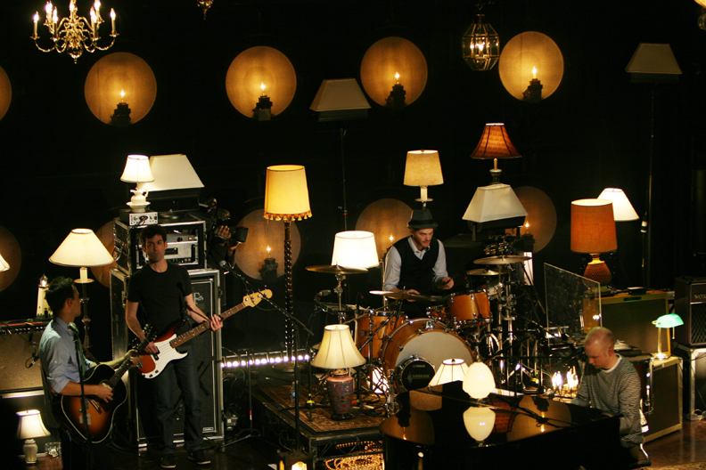
Practical
any item on stage that needs to be electrified whether it is considered scenery, properties, or costumes.

Slide 5
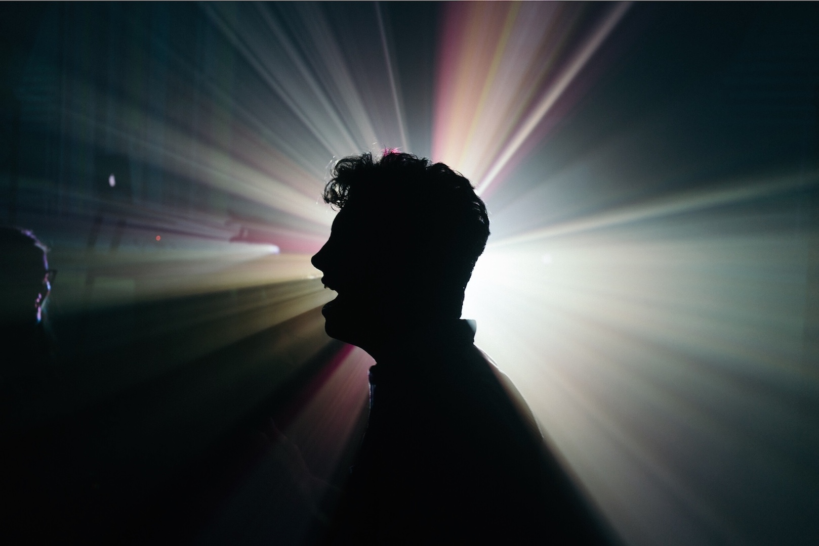
Projection
actor’s technique for making voice, movements, and gestures clear to all parts of the house

Slide 6
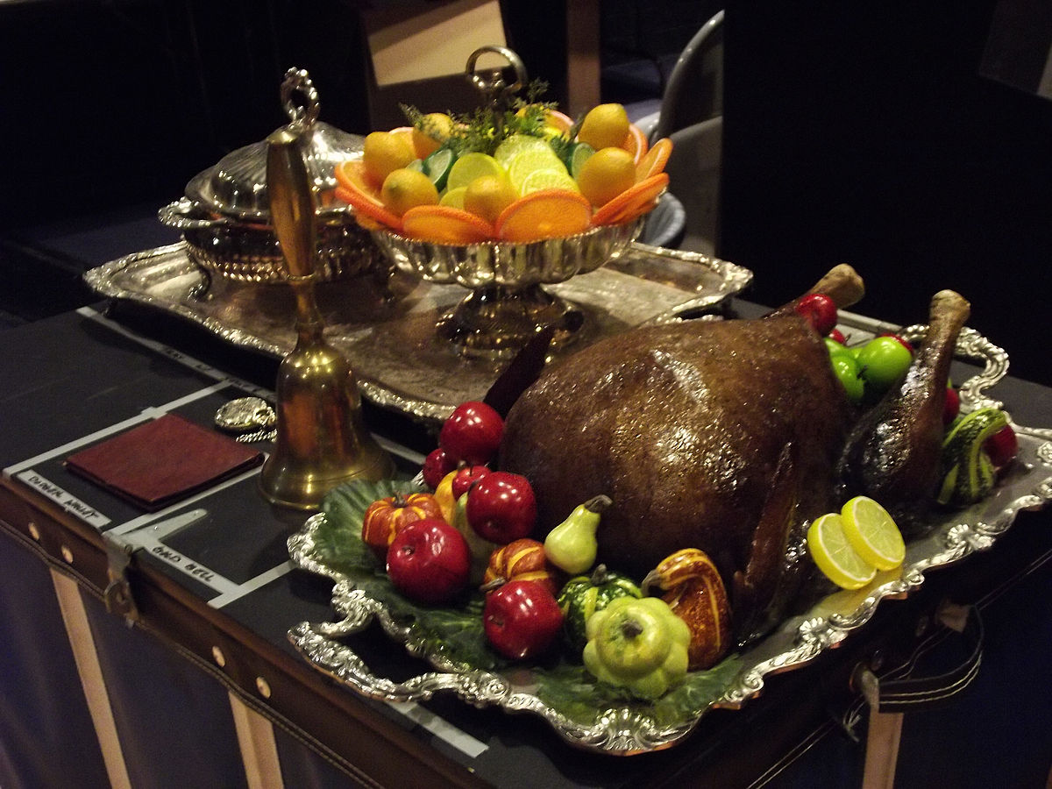
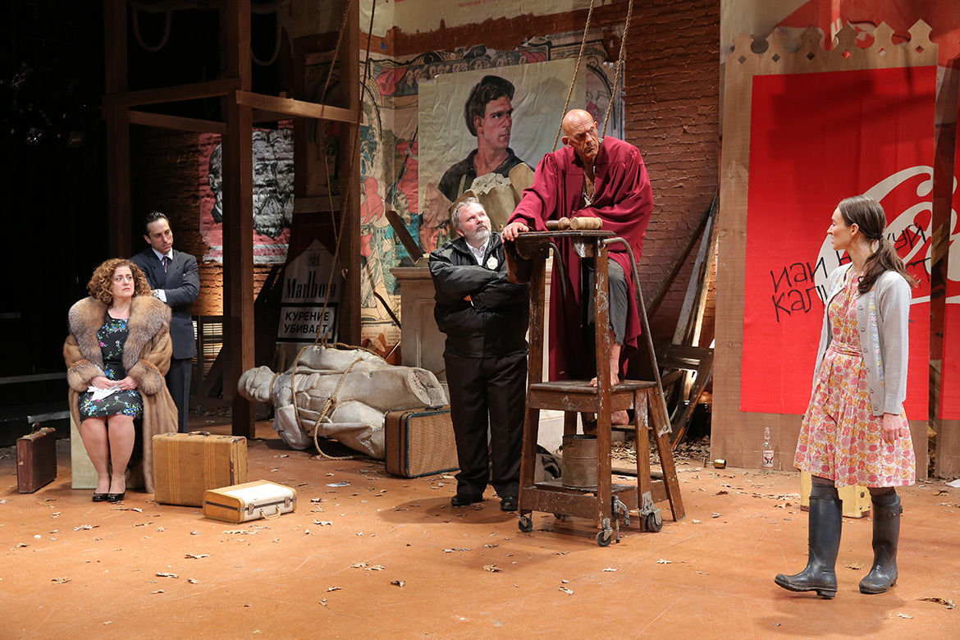
Prop
article or object that is carried by performers or is used on the set

Slide 7
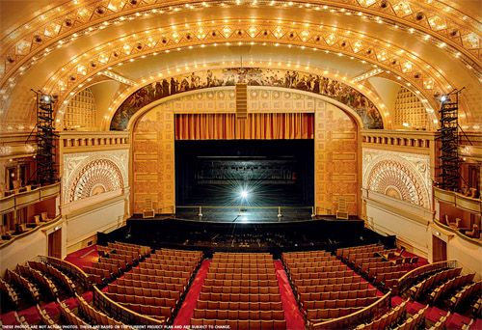
Proscenium Arch
the archway framing the stage. Can be permanent structure or the curtain.

Slide 8
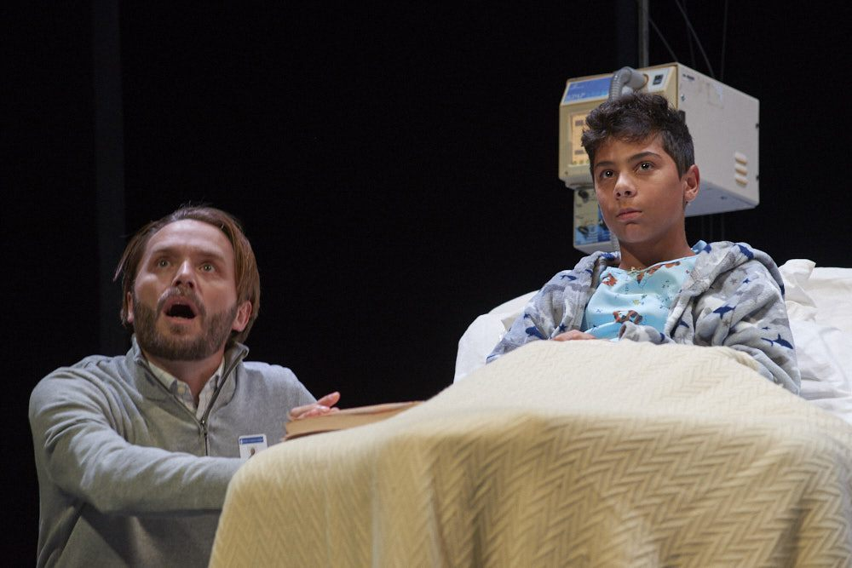
Read
whether or not a prop, accessory or costume can be seen from stage, or how an item is perceived from stage

Slide 9
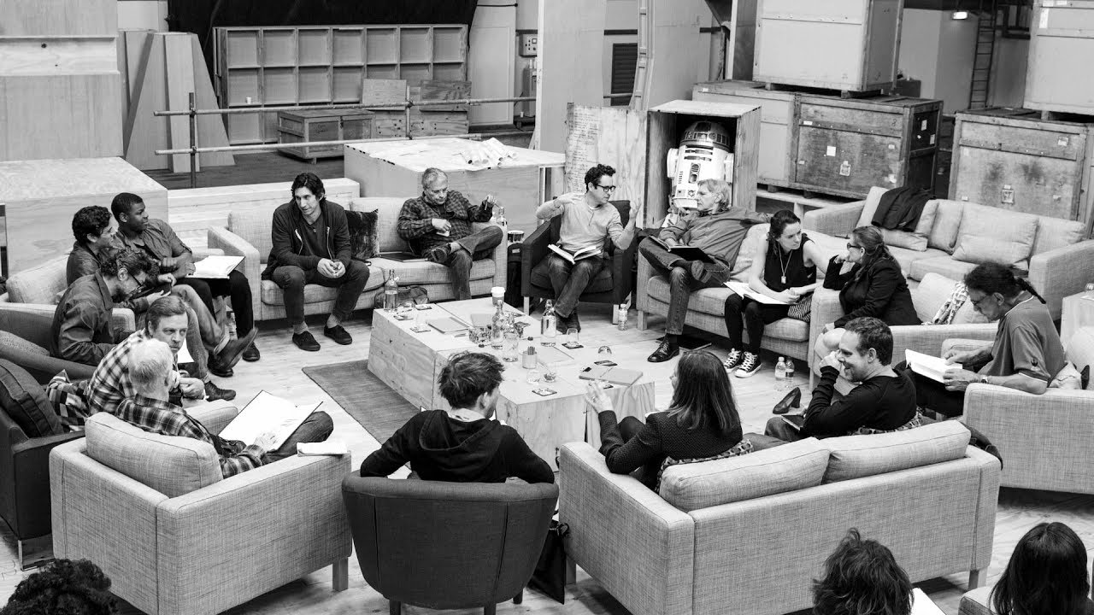
Read Through
Cast and crew reads through the play to clarify meaning and pronunciations and to gain greater insight into character development and interpretation

Slide 10
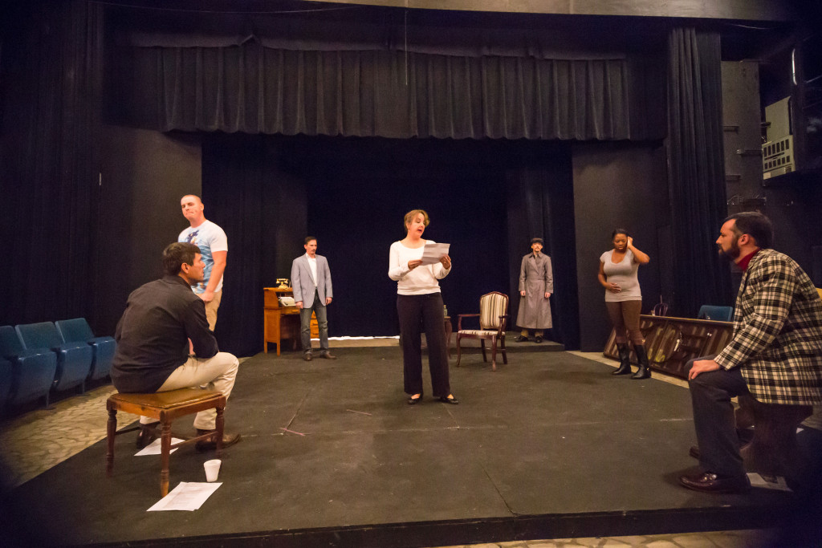
Rehearsal
the time for discussion and analysis of the play, a time for the performers to learn their parts and their blocking

Slide 11
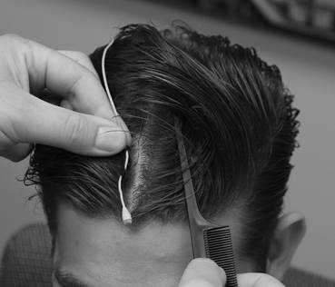
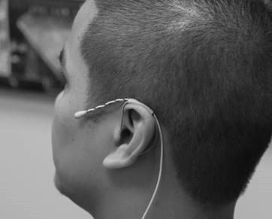
Rig
to put sound equipment on an actor or to place lights.

