Slide 1
Vocab Week 9
R-S

Slide 2
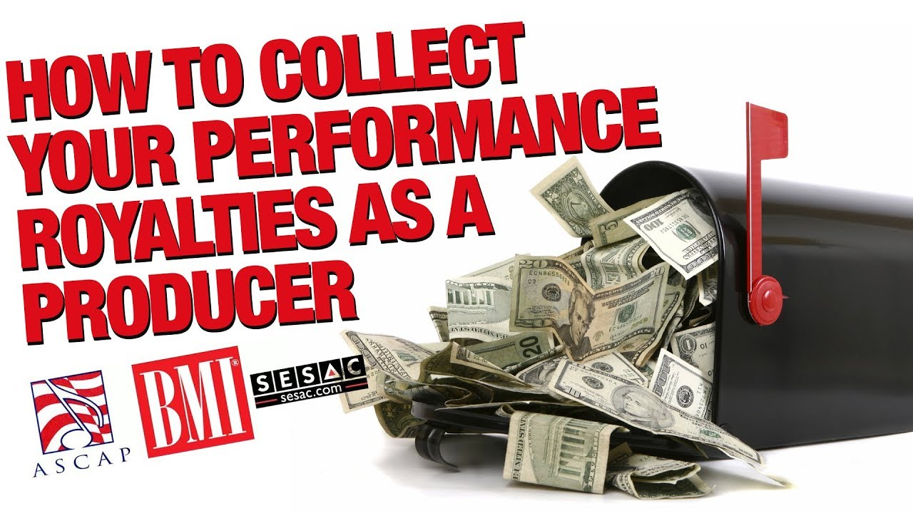
Royalty
the money paid to a copyright company for the right to perform a play.

Slide 3
Run-Through
a rehearsal moving from start to finish without stopping for corrections or notes.

Slide 4
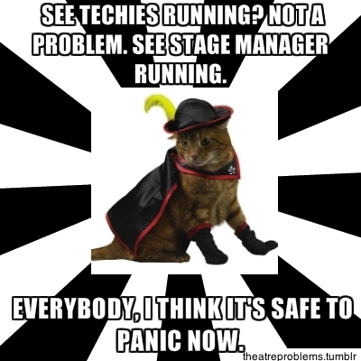
Running Crew
collective term used to describe the members of the technical crew who supervise and run the various technical aspects of the production during a performance.

Slide 5
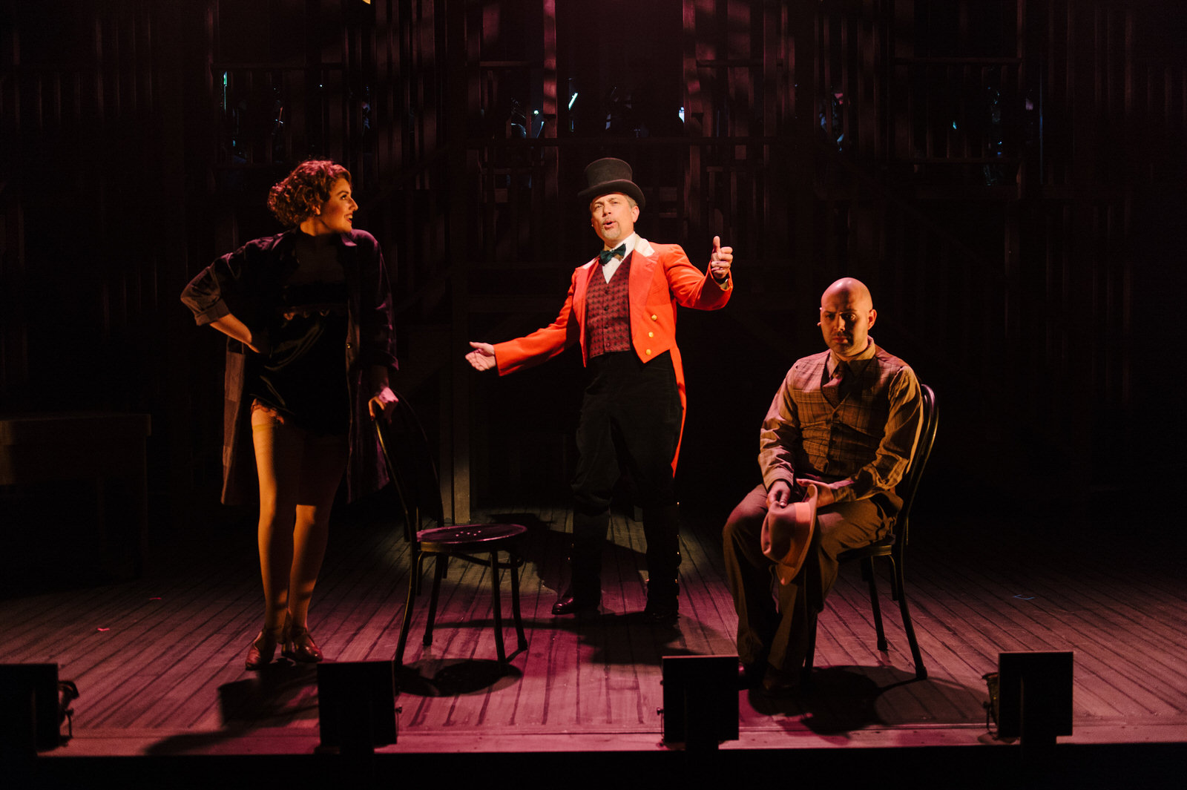
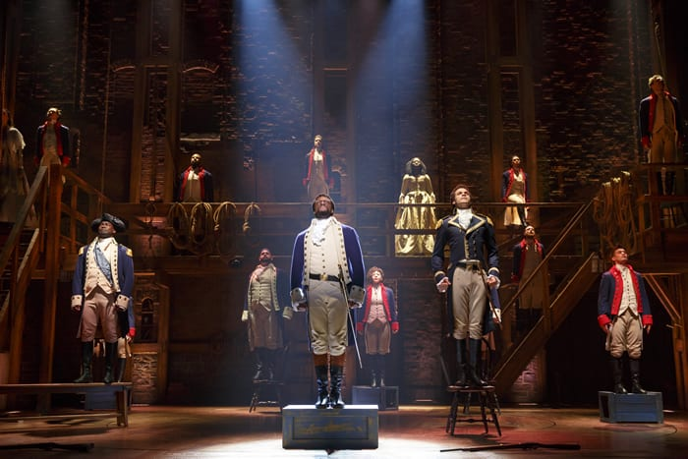
Scene
division of an act, usually denoting a change in time or place; can also be the descriptor for the locale of a play

Slide 6
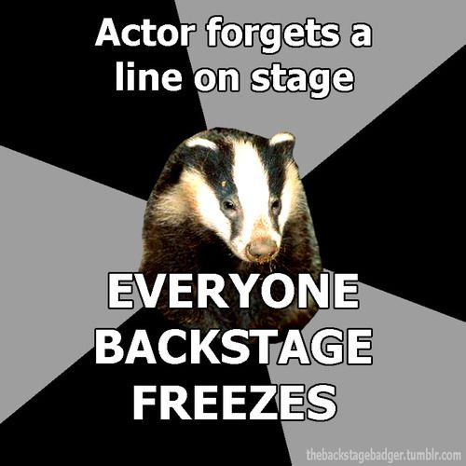
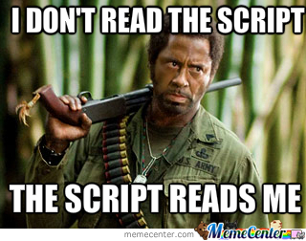
Script
dialogue, lyrics, and stage directions of a musical or play

Slide 7
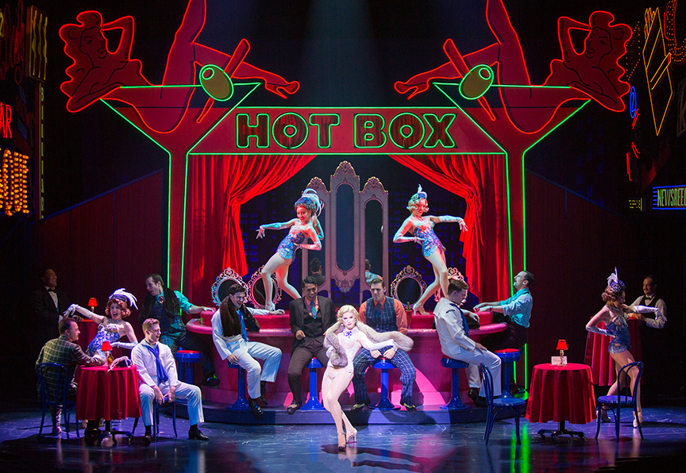
Set/Setting
indicates the place where the action of a play occurs, time and place. Also, the set pieces which show the place.

Slide 8
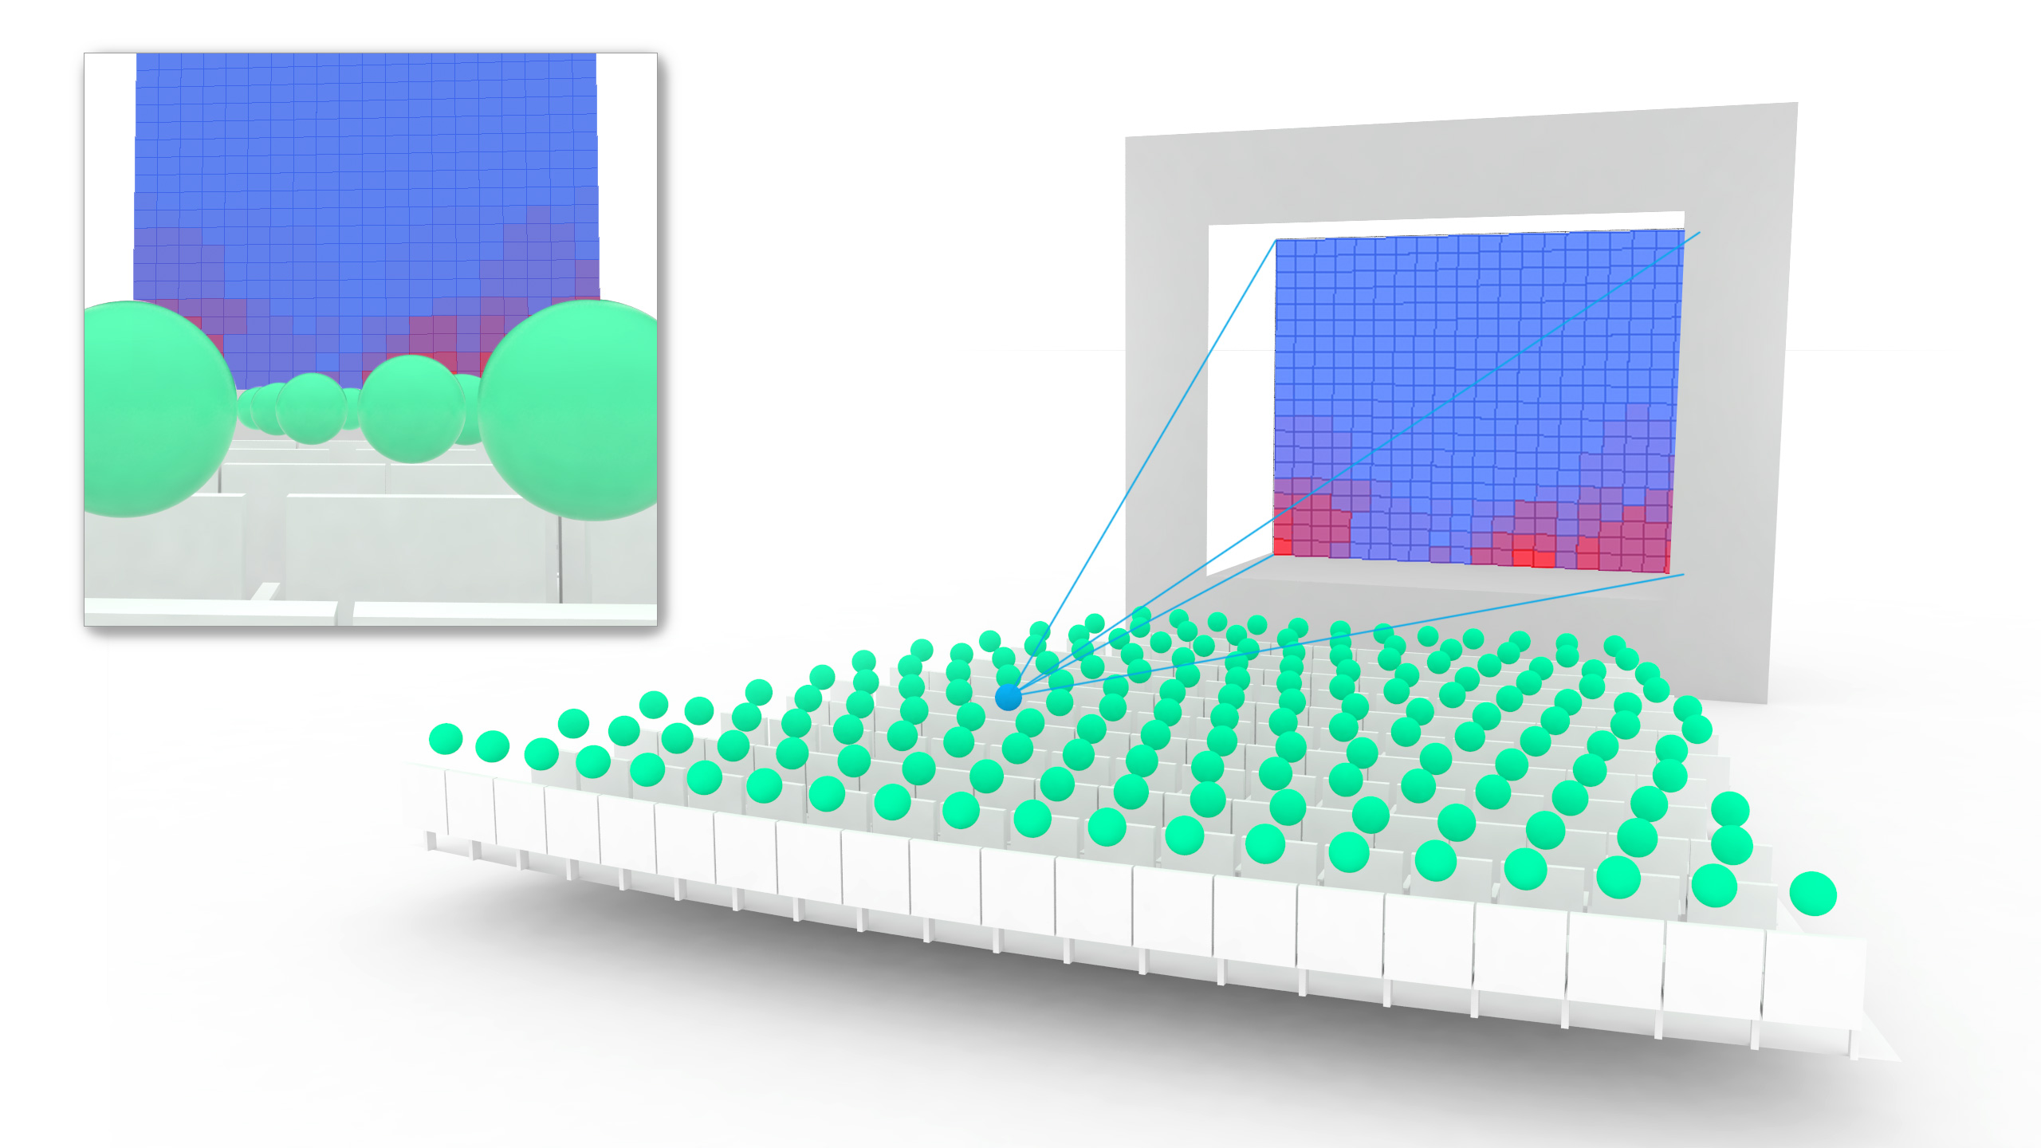
Sightlines
locations in the House where the audience will see on stage.

Slide 9
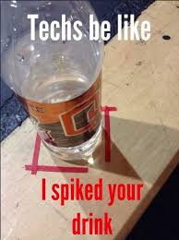
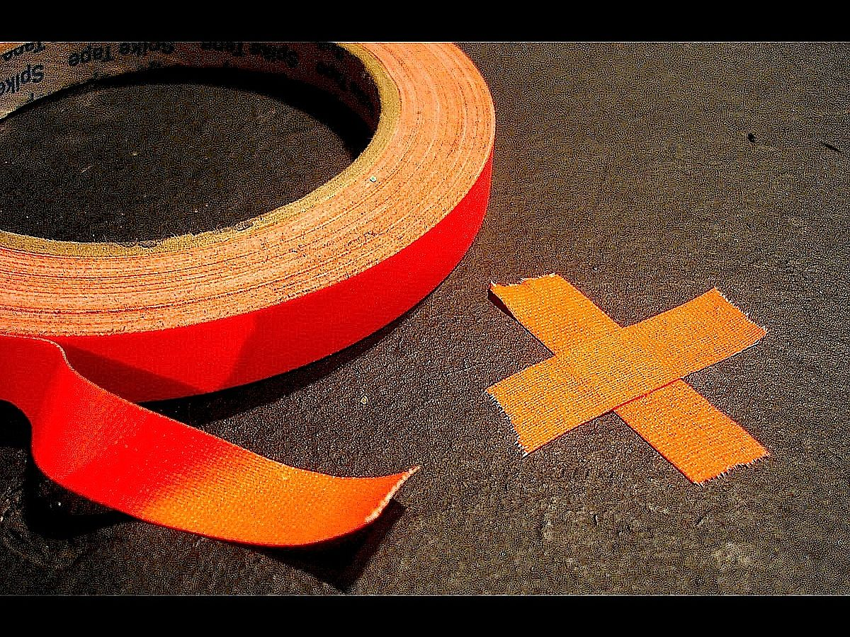
Spike/Stake
a mark, usually made with a piece of glow tape put on or around the stage. Marking is the term for placing a stake.

Slide 10
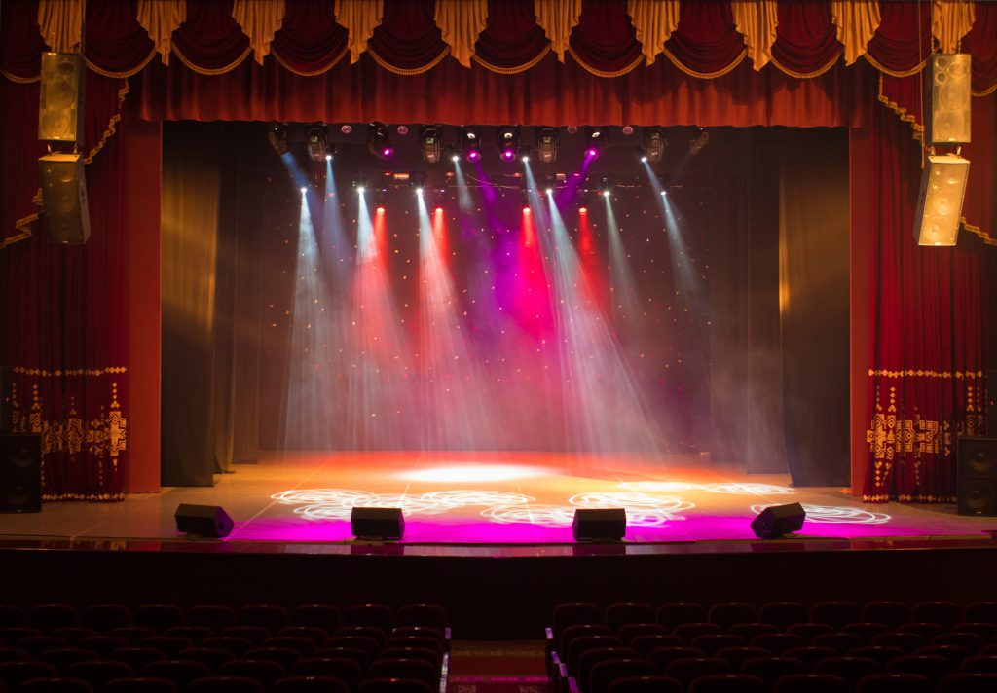
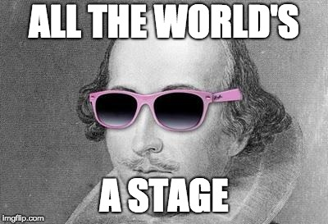
Stage
the area where an actor performs.

Slide 11
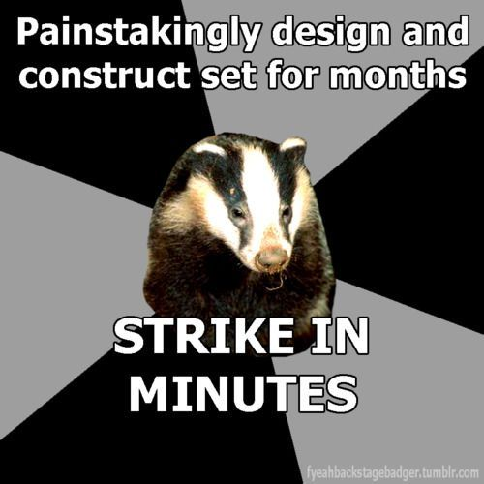
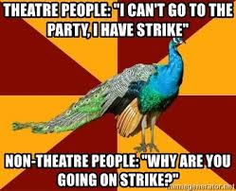
Strike
cast and crew come together to break down the set, put away all costumes and props.

