Slide 1
rhs reyes scholars
Deadline: January 31, 2024

Slide 2
RHS Reyes Scholars Program
Scholarship Eligibility
Must be a graduating senior of Theodore Roosevelt High School in Fresno, California.
Must be accepted and enrolled as a full-time undergraduate student at a 2-year or 4-year institution or a trade school.
Must be enrolled as a full-time student for the Fall 2024 term and through the 2024-2025 academic year.
Must have and maintain a 3.0 out of a 4.0 scale or higher cumulative GPA.
Must demonstrate at least 40 hours of community service for the current year.
No late or incomplete applications will be accepted

Slide 3
New Scholar Instructions
1. Applicant information
2. Parent/Guardian information
3. Activities/Awards/Honors
4. Personal Statement
5. One letter of recommendation
6. Unofficial Transcripts
7. Signature
ONLINE APPLICATION ONLY
You will need a Google Account to apply.
Application Deadline: January 31, 2024

Slide 4
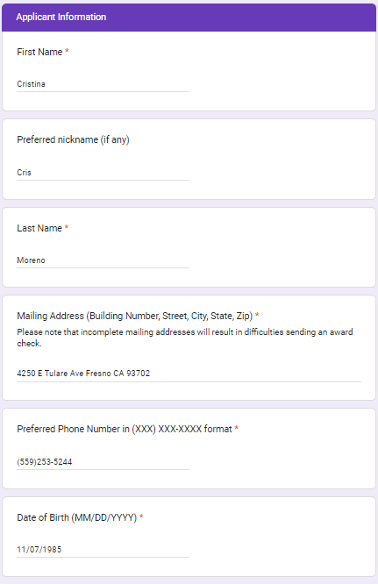
Applicant Information
Full Legal Names
Mailing Address
Phone Number
Academic Major

Slide 5
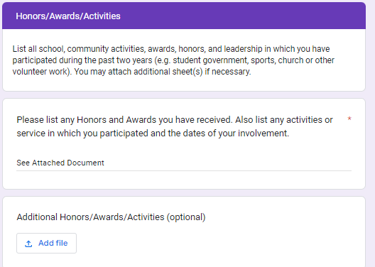
Activities/Honors/Awards
LIST all school, community activities, awards, honors, and leadership in which you have participated during the past two years (e.g. student government, sports, church or other volunteer work). You may attach additional sheet(s) if necessary.
Create a word document listing all Activities/Honors/Awards
Write “see attached document”, then Upload

Slide 6
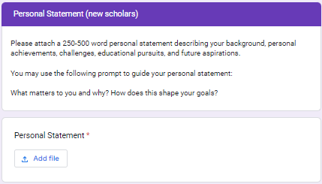
Personal Statement
Please attach a 250-500 word personal statement describing your background, personal achievements, challenges, educational pursuits, and future aspirations. You may use the following prompt to guide your personal statement:
What matters to you and why? How does this shape your goals?
Write on a word document and upload

Slide 7
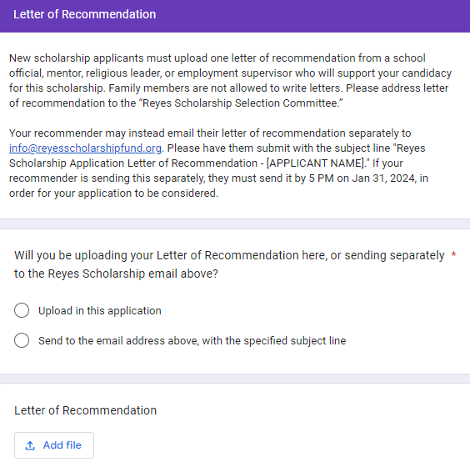
Letter of Recommendation
New scholarship applicants must upload one letter of recommendation from a school official, mentor, religious leader, or employment supervisor who will support your candidacy for this scholarship.
Family members are not allowed to write letters.
Please address letter of recommendation to the “Reyes Scholarship Selection Committee.”
Save Letter as a PDF file to be able to upload

Slide 8
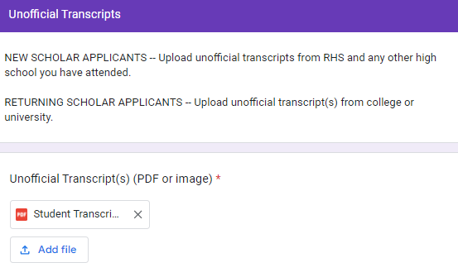
Unofficial Transcript
NEW SCHOLAR APPLICANTS -- Upload unofficial transcripts from RHS and any other high school you have attended (only if there are courses missing from your Roosevelt transcript)
MUST be saved in PDF format in order to upload!

Slide 9
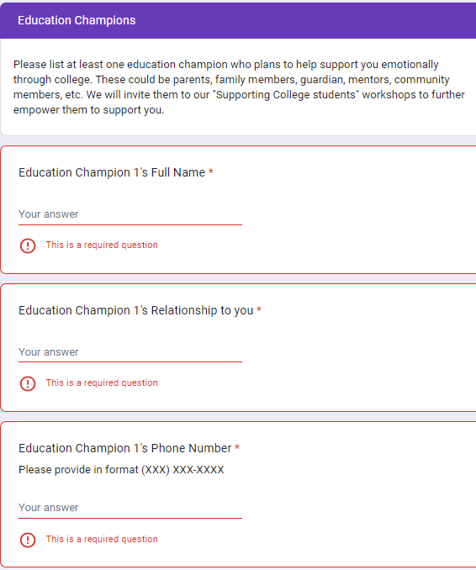
Education Champion
Please list at least one education champion who plans to help support you emotionally through college.
These could be parents, family members, guardian, mentors, community members, etc.
We will invite them to our "Supporting College students" workshops to further empower them to support you.
Name
Relationship
Phone Number
Email Address

Slide 10
Signature and SUBMIT!

Slide 11
Confirmation Email!
Double check that you received a confirmation email
You will be able to go back and edit your application through this email link only

Slide 12
Applicant Interview
Interviews are conducted by the Reyes Scholarship Committee
Held on RHS Campus
Will be provided the date/time of interview
CHECK YOUR SCHOOL EMAIL/TEAMS MESSAGES!
Information sent by Head Counselor Castillo
Dress to impress.
Be yourself.
Answer questions with confidence ☺

